Slide 1
Adaptive(acquired) or specific immunity
Prof dr. Ihsan Edan Alsaimary
department of microbiology – college of medicine – university of basrah Mobile : 07801410838 - e.mail : ihsanalsaimary@gmail.com

Slide 2
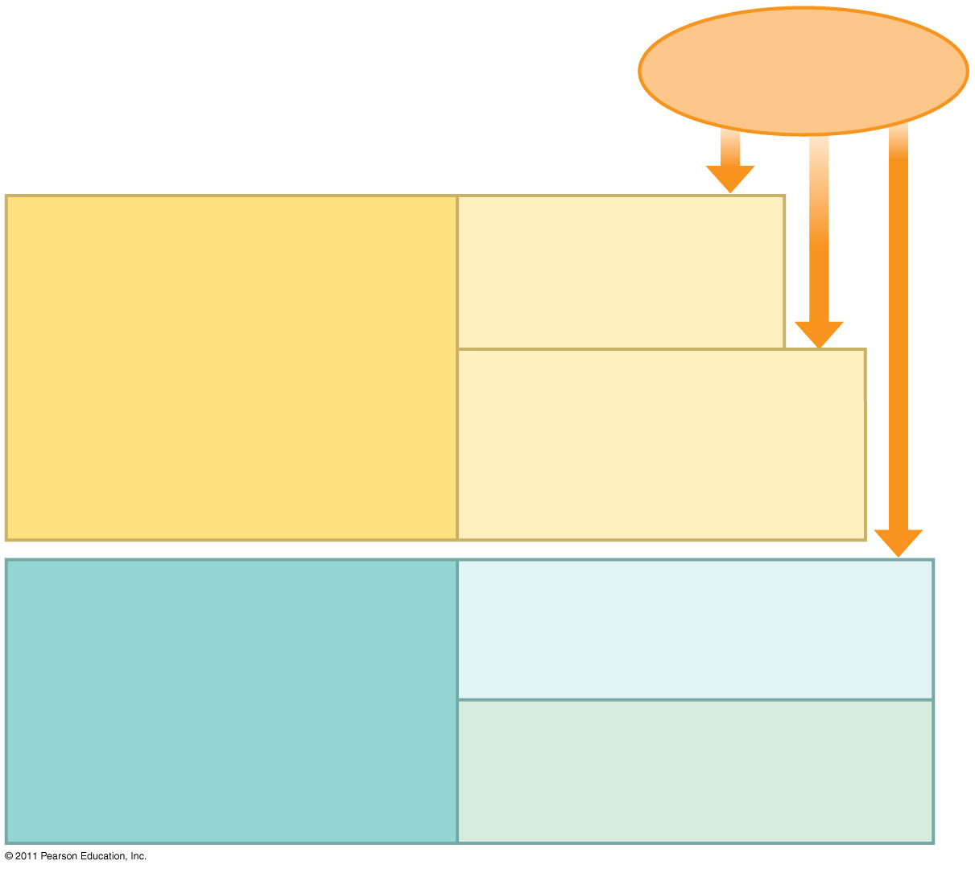
Figure 43.2
Pathogens (such as bacteria, fungi, and viruses)
INNATE IMMUNITY (all animals)
Barrier defenses:
Skin Mucous membranes Secretions
•
Recognition of traits shared by broad ranges of pathogens, using a small set of receptors
Internal defenses:
Phagocytic cells Natural killer cells Antimicrobial proteins Inflammatory response
• Rapid response
ADAPTIVE IMMUNITY (vertebrates only)
Humoral response:
Antibodies defend against infection in body fluids.
•
Recognition of traits specific to particular pathogens, using a vast array of receptors
Cell-mediated response:
Cytotoxic cells defend against infection in body cells.
• Slower response
Notes:
Figure 43.2 Overview of animal immunity.

Slide 3
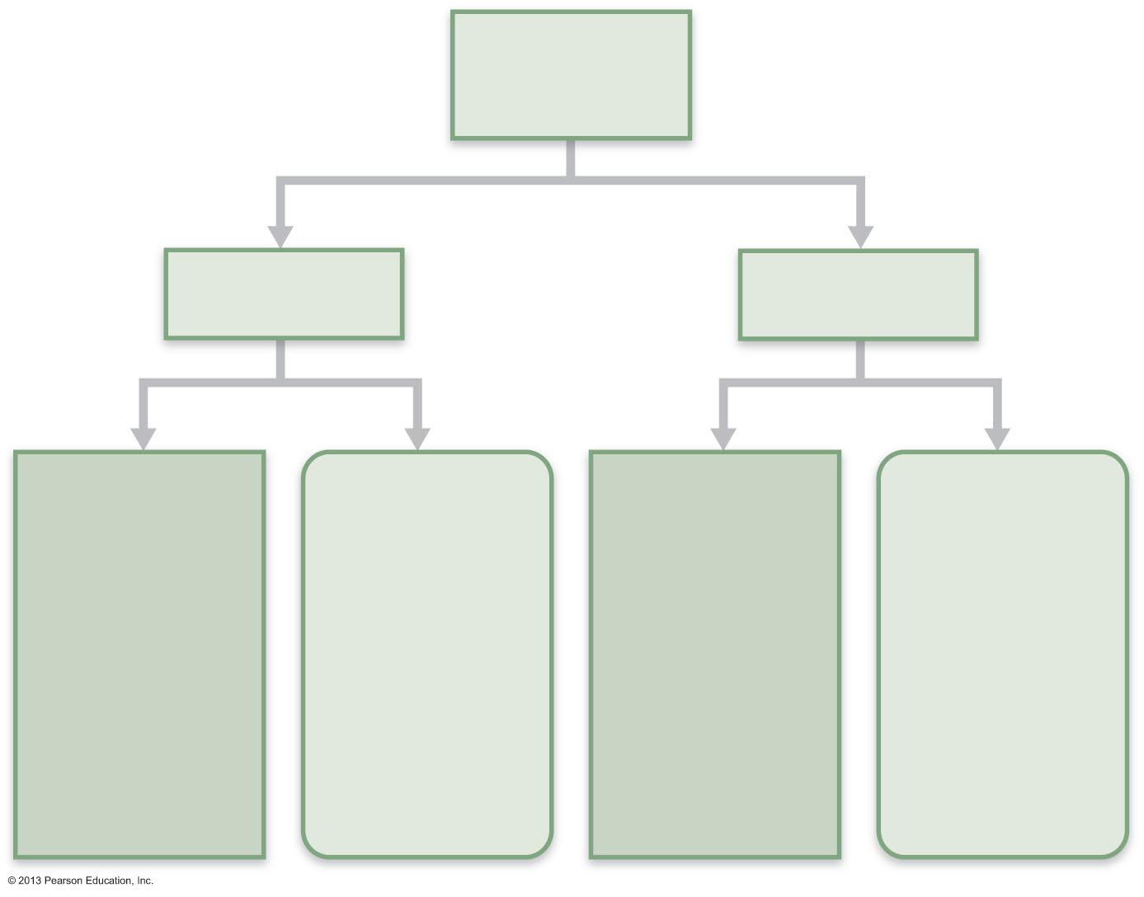
Figure 21.13 Active and passive humoral immunity.
Humoral
immunity
Active
Passive
Naturally
acquired
Artificially
acquired
Naturally
acquired
Artificially
acquired
Infection;
contact
with
pathogen
Vaccine;
dead or
attenuated
pathogens
Antibodies
passed from
mother to
fetus via
placenta; or
to infant in
her milk
Injection of
exogenous
antibodies
(gamma
globulin)

Slide 4
Acquired Immunity
Acquired Immunity is more specialized than other mechanisms of immunity.
Acquired Immunity may be a cell-mediated or it may be a humoral immunity.
These two means of acquired immunity
interact to destroy an invading foreign body.

Slide 5
Acquired Immunity
The humoral immune response:
- antibodies
- antibodies are produced by B-
lymphocytes
- antibodies have the ability to recognize
and bind to the specific antigens that
caused their formation

Slide 6
Acquired Immunity
Cell mediated immune response
- caused by certain types of T-
lymphocytes
- T-lymphocytes recognize foreign
invaders by surface receptors
- T-lymphocytes attack and destroy invaders directly or by releasing soluble substances (cytokines)

Slide 7
Acquired Immunity
Characteristics of Acquired Immunity
- highly specific
- tells the difference between “self” and
“not self” cells
(only “not self” is attacked)
- able to respond to millions of different
invading substances (antigens)

Slide 8
Acquired Immunity
Our lymphocyte population is many different types of specifically cloned lymphocytes
Each type of clone responds to a specific antigen invader

Slide 9
Acquired Immunity
Acquired immune response is initiated by:
- recognition of an antigen by certain
lymphocytes
- activation of these lymphocytes
- differentiation and proliferation into
effector cells
- effector cells eliminate antigen
- development of memory cells
- memory cells give a rapid and long-term
response to re-exposure

Slide 10
Acquired Immunity
Passive Acquired Immunity
- naturally acquired through mother’s placenta
- naturally acquired by mother’s milk
Artificallly acquired immunity from injection of prepared antibodies from another organism

Slide 11
Acquired Immunity
Active Acquired Immunity
- Natural Active Acquired Immunity
- clinical or subclinical infection
(you have the disease and become immune)
- Artificial Acquired Immunity
- following vaccination with live or dead
infectious disease microorganism or
injection of their products

Slide 12
Acquired Immunity
Vaccination
- prevents (and controls) such diseases as Polio, Diptheria, Tetanus, Measles, Mumps, Chickenpox, Hepatitis A and B, and many others
Vaccines work with the bodies nature mechanisms by causing the body to produce antibodies against the microorganisms

Slide 13
Acquired Immunity
Your body recognizes and destroys foreign antigens (proteins)
You have been vaccinated for several diseases. For some other diseases you may have natural acquired immunity because you have had the disease.

Slide 14
Adaptive Defenses
Adaptive immune (specific defense) system
Protects against infectious agents and abnormal body cells
Amplifies inflammatory response
Activates complement
Must be primed by initial exposure to specific foreign substance
Priming takes time

Slide 15
Adaptive Defenses
Specific – recognizes and targets specific antigens
Systemic – not restricted to initial site
Have memory – stronger attacks to "known" antigens
Two separate, overlapping arms
Humoral (antibody-mediated) immunity
Cellular (cell-mediated) immunity

Slide 16
Humoral Immunity
Antibodies, produced by lymphocytes, circulating freely in body fluids
Bind temporarily to target cell
Temporarily inactivate
Mark for destruction by phagocytes or complement
Humoral immunity has extracellular targets

Slide 17
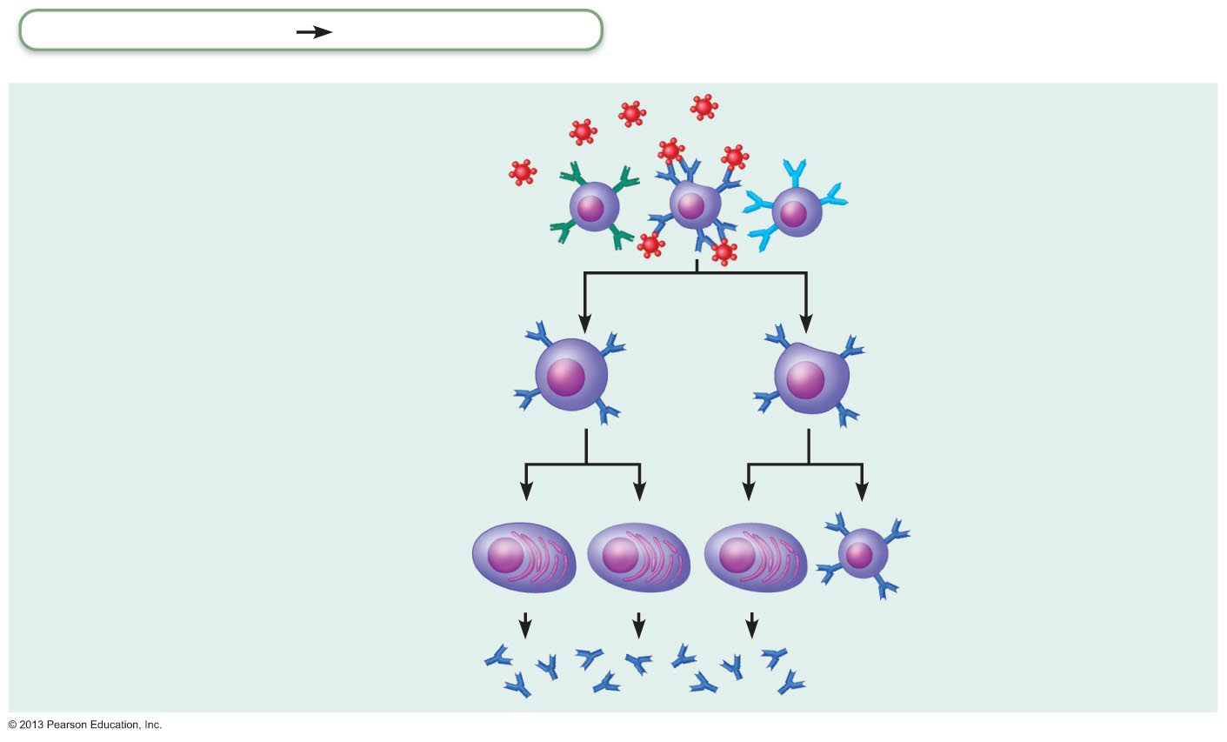
Figure 21.11a Clonal selection of a B cell.
Adaptive defenses
Humoral immunity
Primary response
(initial encounter
with antigen)
Antigen
Antigen binding
to a receptor on a
specific B lymphocyte
(B lymphocytes with
noncomplementary
receptors remain
inactive)
Proliferation to
form a clone
Activated B cells
Plasma cells
(effector B cells)
Memory B cell—
primed to respond
to same antigen
Secreted
antibody
molecules

Slide 18
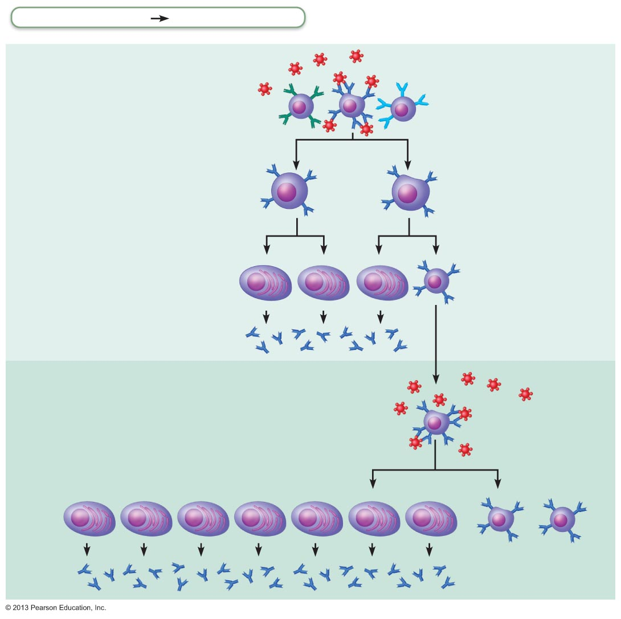
Figure 21.11 Clonal selection of a B cell.
Adaptive defenses
Humoral immunity
Primary response
(initial encounter
with antigen)
Antigen
Antigen binding
to a receptor on a
specific B lymphocyte
(B lymphocytes with
noncomplementary
receptors remain
inactive)
Proliferation to
form a clone
Activated B cells
Plasma cells
(effector B cells)
Memory B cell—
primed to respond
to same antigen
Secreted
antibody
molecules
Secondary response
(can be years later)
Clone of cells
identical to
ancestral cells
Subsequent
challenge by same
antigen results in
more rapid response
Plasma
cells
Secreted
antibody
molecules
Memory
B cells

Slide 19
Cellular Immunity
Lymphocytes act against target cell
Directly – by killing infected cells
Indirectly – by releasing chemicals that enhance inflammatory response; or activating other lymphocytes or macrophages
Cellular immunity has cellular targets

Slide 20
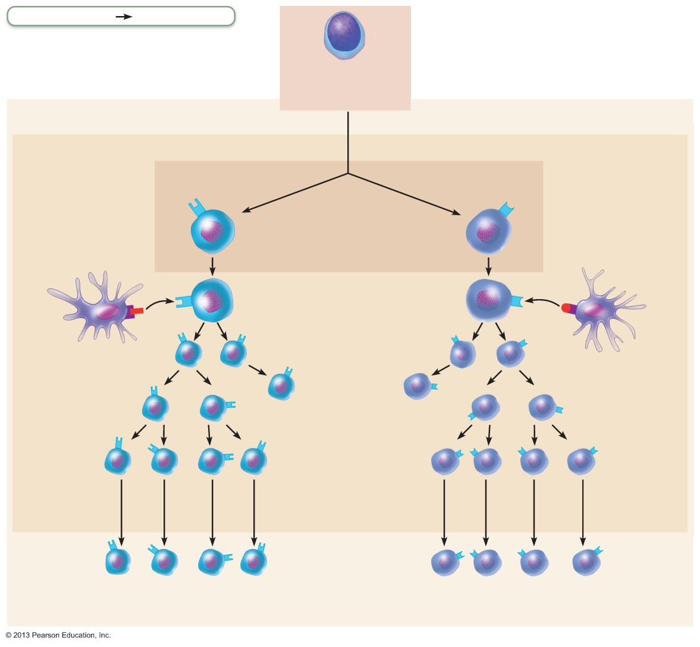
Figure 21.16 Major types of T cells.
Adaptive defenses
Cellular immunity
Immature
lymphocyte
Red bone marrow
T cell
receptor
T cell
receptor
Maturation
Class II MHC
protein displaying
antigen
CD4
cell
CD8
cell
Class I MHC
protein displaying
antigen
Thymus
Activation
Activation
APC
(dendritic cell)
Memory
cells
APC
(dendritic cell)
CD4
CD8
CD4 cells become
either helper T
cells or
regulatory T cells
Lymphoid
tissues and
organs
CD8 cells become
cytotoxic T
cells
Effector
cells
Blood plasma

Slide 21
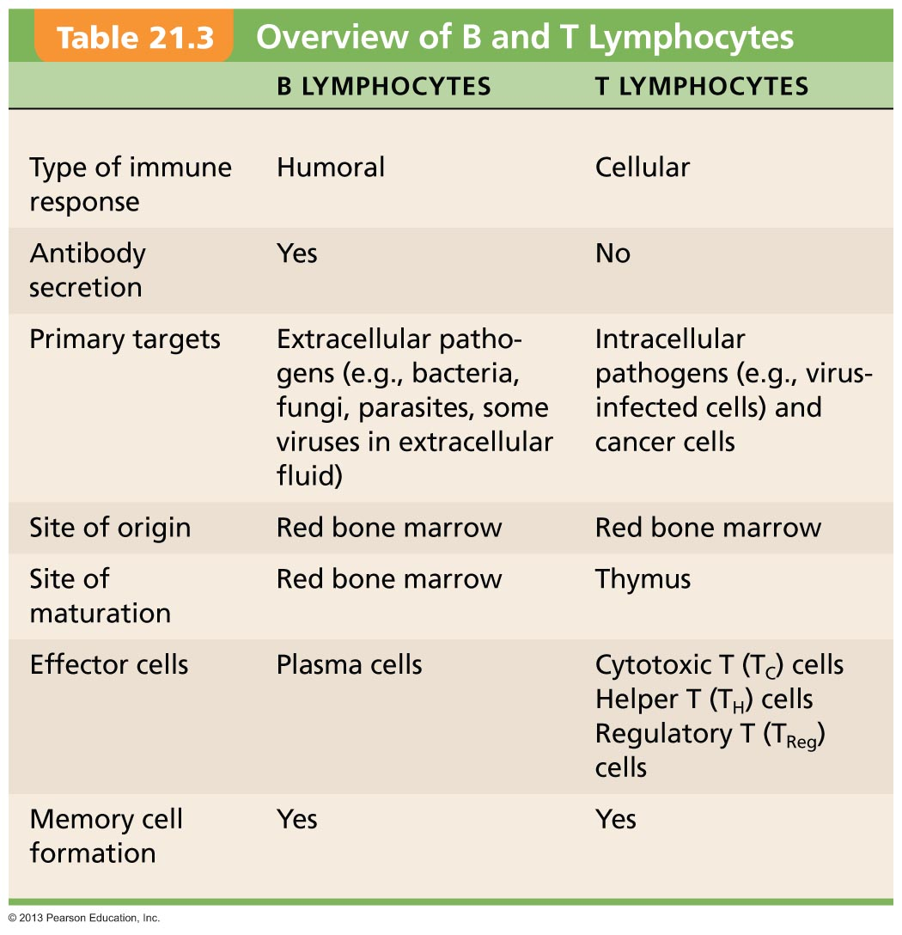
Table 21.3 Overview of B and T Lymphocytes
Notes:
21

Slide 22
Antigens
Substances that can mobilize adaptive defenses and provoke an immune response
Targets of all adaptive immune responses
Most are large, complex molecules not normally found in body (nonself)

Slide 23
Complete Antigens
Important functional properties
Immunogenicity: ability to stimulate proliferation of specific lymphocytes
Reactivity: ability to react with activated lymphocytes and antibodies released by immunogenic reactions
Examples: foreign protein, polysaccharides, lipids, and nucleic acids

Slide 24
Haptens (Incomplete Antigens)
Small molecules (haptens) not immunogenic by themselves
E.g., peptides, nucleotides, some hormones
May be immunogenic if attached to body proteins and combination is marked foreign
Cause immune system to mount harmful attack
Examples: poison ivy, animal dander, detergents, and cosmetics

Slide 25
Antigenic Determinants
Only certain parts (antigenic determinants) of entire antigen are immunogenic
Antibodies and lymphocyte receptors bind to them as enzyme binds substrate

Slide 26
Antigenic Determinants
Most naturally occurring antigens have numerous antigenic determinants that
Mobilize several different lymphocyte populations
Form different kinds of antibodies against them
Large, chemically simple molecules (e.g., plastics) have little or no immunogenicity

Slide 27
Figure 21.7 Most antigens have several different antigenic determinants.
Antigen-
binding
sites
Antigenic determinants
Antibody A
Antigen
Antibody B
Antibody C

Slide 28
Self-antigens: MHC Proteins
Protein molecules (self-antigens) on surface of cells not antigenic to self but antigenic to others in transfusions or grafts
Example: MHC glycoproteins
Coded by genes of major histocompatibility complex (MHC) and unique to individual
Have groove holding self- or foreign antigen
T lymphocytes can only recognize antigens that are presented on MHC proteins

Slide 29
Cells of the Adaptive Immune System
Three types of cells
Two types of lymphocytes
B lymphocytes (B cells)—humoral immunity
T lymphocytes (T cells)—cellular immunity
Antigen-presenting cells (APCs)
Do not respond to specific antigens
Play essential auxiliary roles in immunity

Slide 30
Lymphocyte Development, Maturation, and Activation
Five general steps
Origin – all originate in red bone marrow
Maturation
Seeding secondary lymphoid organs and circulation
Antigen encounter and activation
Proliferation and differentiation

Slide 31
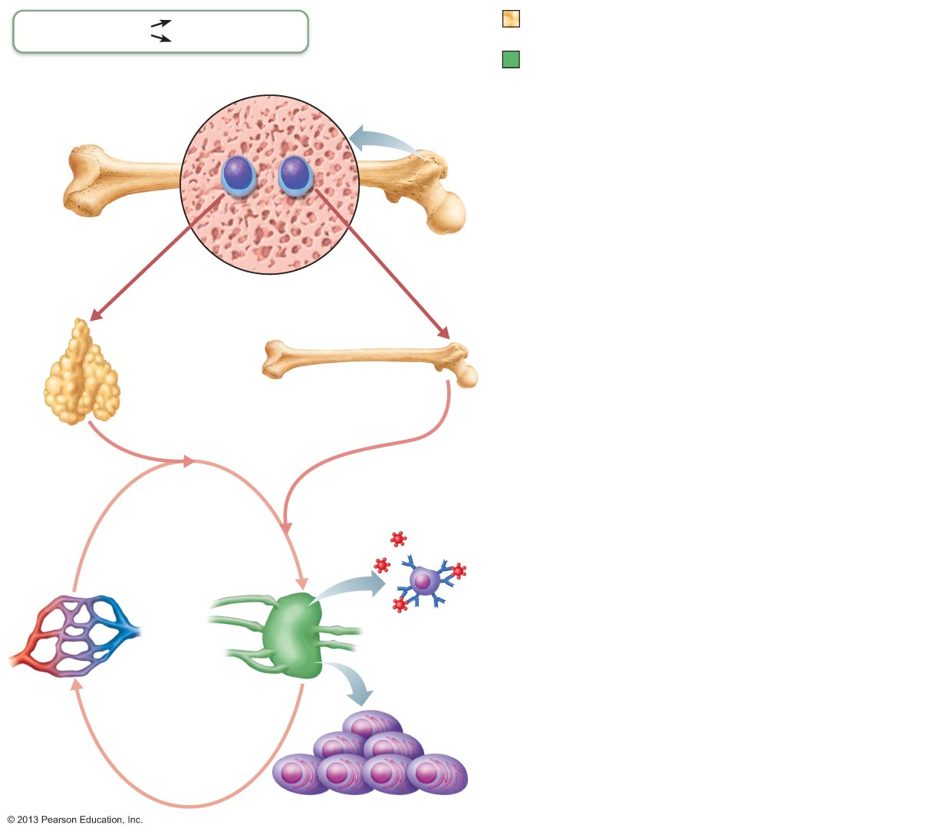
Figure 21.8 Lymphocyte development, maturation, and activation.
Slide 1
Adaptive defenses
Humoral immunity
Primary lymphoid organs
(red bone marrow and thymus)
Cellular immunity
Secondary lymphoid organs
(lymph nodes, spleen, etc.)
Red bone marrow
Red bone marrow
1
Origin
• Both B and T lymphocyte precursors originate in red
bone marrow.
Lymphocyte
precursors
2
Maturation
• Lymphocyte precursors destined to become T cells migrate
(in blood) to the thymus and mature there.
• B cells mature in the bone marrow.
• During maturation lymphocytes develop immunocompetence
and self-tolerance.
Thymus
Red bone marrow
3
Seeding secondary lymphoid organs and circulation
• Immunocompetent but still naive lymphocytes leave the
thymus and bone marrow.
• They “seed” the secondary lymphoid organs and circulate
through blood and lymph.
Antigen
4
Lymph node
Antigen encounter and activation
• When a lymphocyte’s antigen receptors bind its antigen, that
lymphocyte can be activated.
Proliferation and differentiation
• Activated lymphocytes proliferate (multiply) and then
differentiate into effector cells and memory cells.
• Memory cells and effector T cells circulate continuously in
the blood and lymph and throughout the secondary
lymphoid organs.
5
Notes:
31

Slide 32
Maturation
"Educated" to become mature; B cells in bone marrow, T cells in thymus
Immunocompetence – lymphocyte can recognize one specific antigen by binding to it
B or T cells display only one unique type of antigen receptor on surface when achieve maturity – bind only one antigen
Self-tolerance
Lymphocytes unresponsive to own antigens

Slide 33
T cells
T cells mature in thymus under negative and positive selection pressures ("tests")
Positive selection
Selects T cells capable of recognizing self-MHC proteins (MHC restriction); failures destroyed by apoptosis
Negative selection
Prompts apoptosis of T cells that bind to self-antigens displayed by self-MHC
Ensures self-tolerance

Slide 34
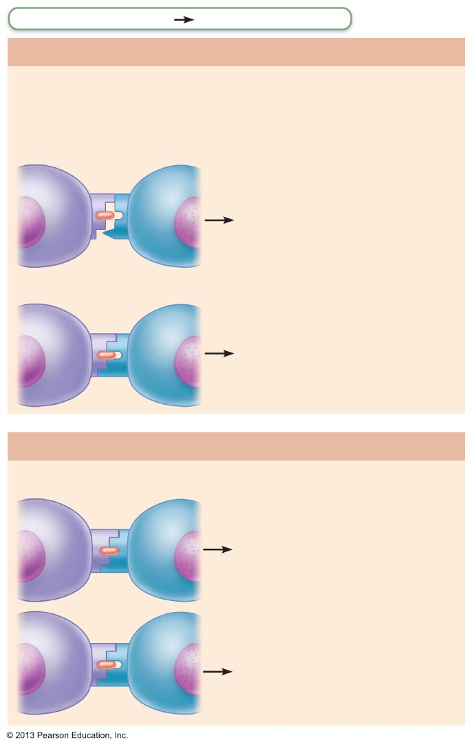
Figure 21.9 T cell education in the thymus.
Adaptive defenses
Cellular immunity
1. Positive Selection
T cells must recognize self major histocompatibility
proteins (self-MHC)
Antigen-
presenting
thymic cell
Developing
T cell
Failure to recognize self-
MHC results in apoptosis
(death by cell suicide).
Self-MHC
T cell receptor
Self-antigen
Recognizing self-MHC
results in survival.
Survivors proceed
to negative selection.
2. Negative Selection
T cells must not recognize self-antigens
Recognizing self-antigen
results in apoptosis. This
eliminates self-reactive
T cells that could cause
autoimmune diseases.
Failure to recognize (bind
tightly to) self-antigen
results in survival and
continued maturation.

Slide 35
B cells
B cells mature in red bone marrow
Positively selected if successfully make antigen receptors
Those that are self-reactive
Eliminated by apoptosis (clonal deletion)

Slide 36
Antigen Encounter and Activation
Clonal selection
Naive lymphocyte's first encounter with antigen → selected for further development
If correct signals present, lymphocyte will complete its differentiation

Slide 37
Immunological Memory
Primary immune response
Cell proliferation and differentiation upon first antigen exposure
Lag period: three to six days
Peak levels of plasma antibody are reached in 10 days
Antibody levels then decline

Slide 38
Immunological Memory
Secondary immune response
Re-exposure to same antigen gives faster, more prolonged, more effective response
Sensitized memory cells respond within hours
Antibody levels peak in two to three days at much higher levels
Antibodies bind with greater affinity
Antibody level can remain high for weeks to months

Slide 39
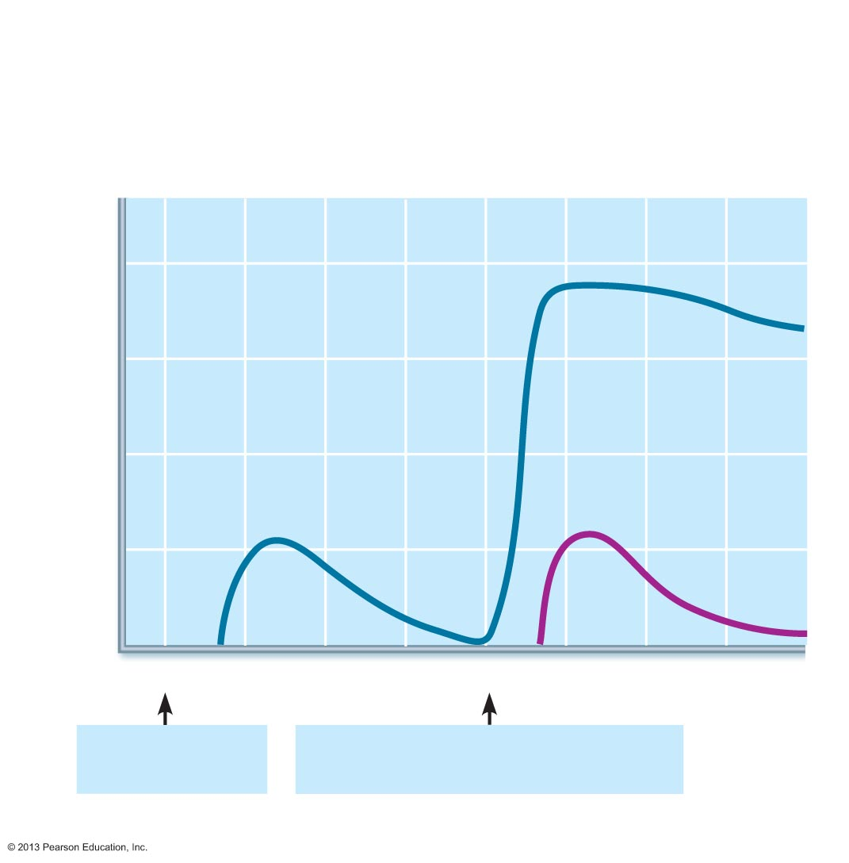
Figure 21.12 Primary and secondary humoral responses.
Secondary immune response to
antigen A is faster and larger; primary
immune response to antigen B is
similar to that for antigen A.
Primary immune
response to antigen
A occurs after a delay.
10⁴
10³
Antibody titer (antibody concentration)
in plasma (arbitrary units)
10²
10¹
Anti-
Bodies
to B
Anti-
Bodies
to A
10⁰
0
7
14
21
28
35
42
49
56
First exposure
to antigen A
Second exposure to antigen A;
first exposure to antigen B
Time (days)

Slide 40
Active Humoral Immunity
When B cells encounter antigens and produce specific antibodies against them
Two types of active humoral immunity:
Naturally acquired—response to bacterial or viral infection
Artificially acquired—response to vaccine of dead or attenuated pathogens

Slide 41
Active Humoral Immunity
Vaccines
Most of dead or attenuated pathogens
Spare us symptoms of primary response
Provide antigenic determinants that are immunogenic and reactive

Slide 42
Passive Humoral Immunity
Readymade antibodies introduced into body
B cells are not challenged by antigens
Immunological memory does not occur
Protection ends when antibodies degrade

Slide 43
Passive Humoral Immunity
Two types
Naturally acquired—antibodies delivered to fetus via placenta or to infant through milk
Artificially acquired—injection of serum, such as gamma globulin
Protection immediate but ends when antibodies naturally degrade in body

Slide 44
Antibodies
Immunoglobulins—gamma globulin portion of blood
Proteins secreted by plasma cells
Capable of binding specifically with antigen detected by B cells
Grouped into one of five Ig classes

Slide 45
Basic Antibody Structure
Constant (C) regions of stem
Determine antibody class (IgM, IgA, IgD, IgG, or IgE)
Serve common functions in all antibodies by dictating
Cells and chemicals that antibody can bind
How antibody class functions to eliminate antigens

Slide 46
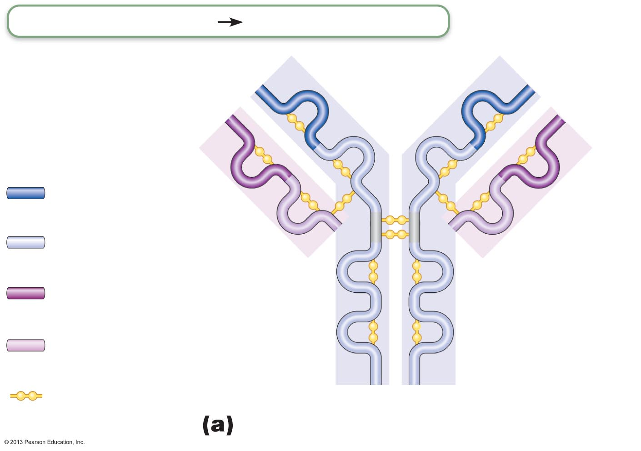
Figure 21.14a Antibody structure.
Adaptive defenses
Humoral immunity
Antigen-binding
site
Heavy chain
Heavy chain
variable region
Light chain
Heavy chain
constant region
Hinge region
Light chain
variable region
Stem region
Light chain
constant region
Disulfide bond

Slide 47
Classes of Antibodies
IgM
Pentamer (larger than others); first antibody released
Potent agglutinating agent
Readily fixes and activates complement
IgA (secretory IgA)
Monomer or dimer; in mucus and other secretions
Helps prevent entry of pathogens

Slide 48
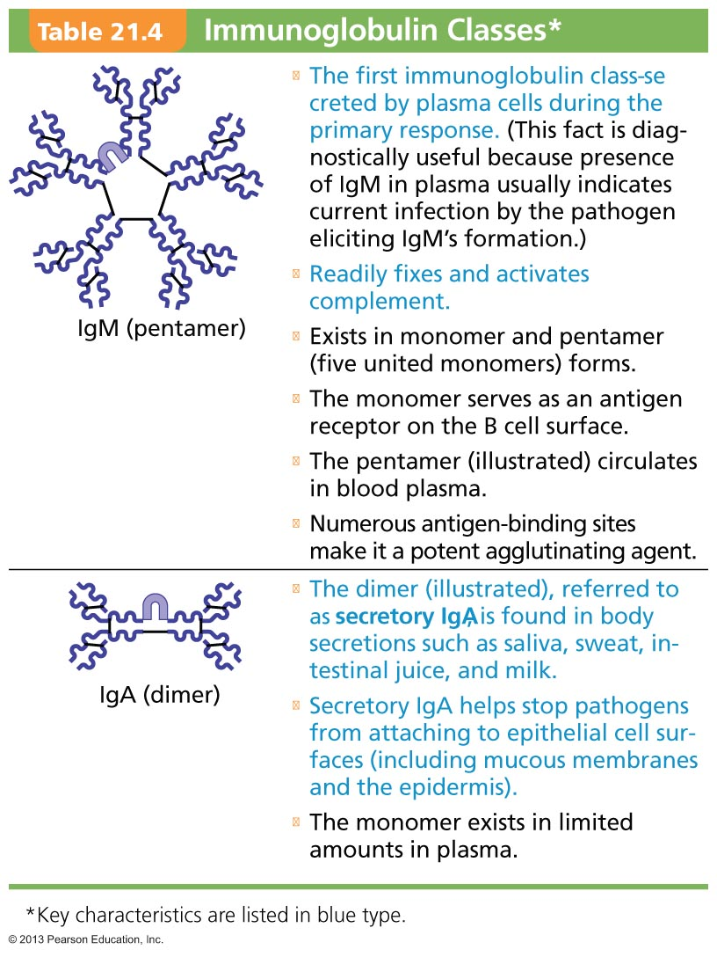
Table 21.4 Immunoglobulin Classes (1 of 2)

Slide 49
Classes of Antibodies
IgD
Monomer attached to surface of B cells
Functions as B cell receptor
IgG
Monomer; 75–85% of antibodies in plasma
From secondary and late primary responses
Crosses placental barrier

Slide 50
Classes of Antibodies
IgE
Monomer active in some allergies and parasitic infections (EEEK !)
Causes mast cells and basophils to release histamine
B cells can switch antibody classes but retain antigen specificity
IgM at first; then IgG
Almost all secondary responses are IgG

Slide 51
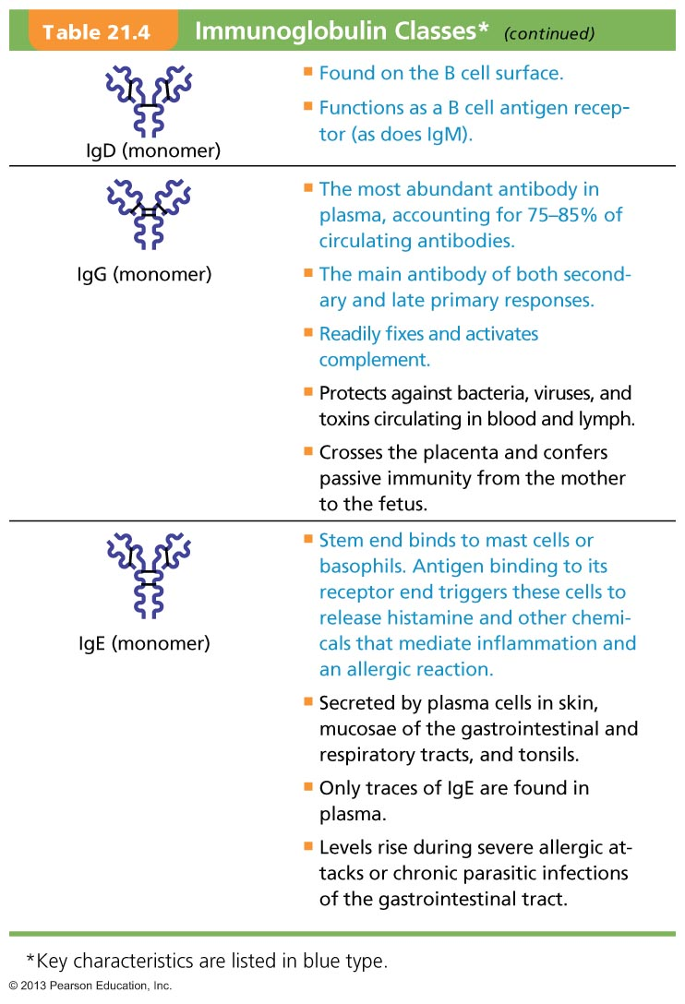
Table 21.4 Immunoglobulin Classes (2 of 2)

Slide 52
Antibody Targets and Functions
Antibodies inactivate and tag antigens; do not destroy them
Form antigen-antibody (immune) complexes
Defensive mechanisms used by antibodies
Neutralization and agglutination (the two most important)
Precipitation and complement fixation

Slide 53
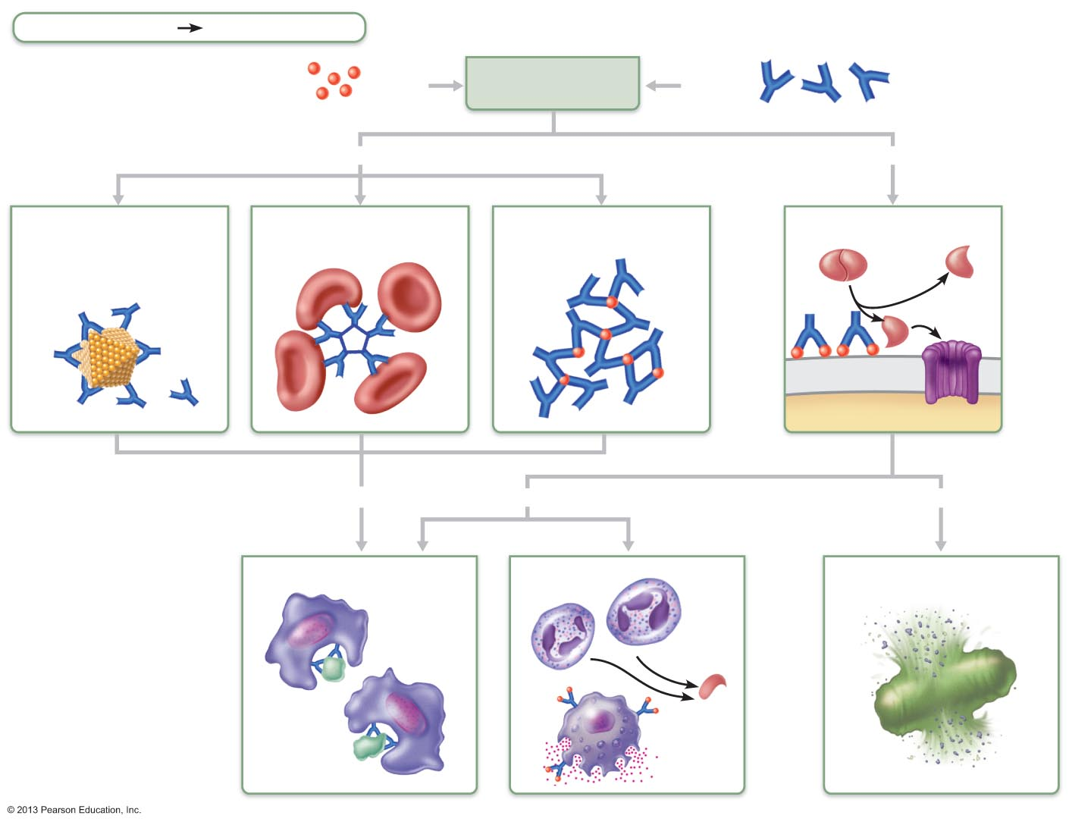
Figure 21.15 Mechanisms of antibody action.
Adaptive defenses
Humoral immunity
Antigen
Antigen-antibody
complex
Antibody
Inactivates by
Fixes and activates
Neutralization
(masks dangerous
parts of bacterial
exotoxins; viruses)
Agglutination
(cell-bound antigens)
Precipitation
(soluble antigens)
Complement
Enhances
Enhances
Leads to
Phagocytosis
Inflammation
Cell lysis
Chemotaxis
Histamine
release

Slide 54
T cell Activation: Proliferation and Differentiation
Primary T cell response peaks within a week
T cell apoptosis occurs between days 7 and 30
Benefit of apoptosis: activated T cells are a hazard – produce large amount inflammatory cytokines → hyperplasia, cancer
Effector activity wanes as amount of antigen declines
Memory T cells remain and mediate secondary responses

Slide 55
Cytokines
Chemical messengers of immune system
Mediate cell development, differentiation, and responses in immune system
Include interferons and interleukins
Interleukin 1 (IL-1) released by macrophages co-stimulates bound T cells to
Release interleukin 2 (IL-2)
Synthesize more IL-2 receptors

Slide 56
Cytokines
IL-2 key growth factor, acting on cells that release it and other T cells
Encourages activated T cells to divide rapidly
Other cytokines amplify and regulate innate and adaptive responses
E.g., tumor necrosis factor – cell toxin
E.g., gamma interferon – enhances killing power of macrophages

Slide 57
Roles of Helper T (T_{H}) cells
Play central role in adaptive immune response
Activate both humoral and cellular arms
Once primed by APC presentation of antigen, they
Help activate T and B cells
Induce T and B cell proliferation
Their cytokines recruit other immune cells
Without T_{H}, there is no immune response

Slide 58
Helper T cells: Activation of B cells
Interact directly with B cells displaying antigen fragments bound to MHC II receptors
Stimulate B cells to divide more rapidly and begin antibody formation
B cells may be activated without T_{H} cells by binding to T cell–independent antigens
Response weak and short-lived
Most antigens require T_{H} co-stimulation to activate B cells: T cell–dependent antigens

Slide 59
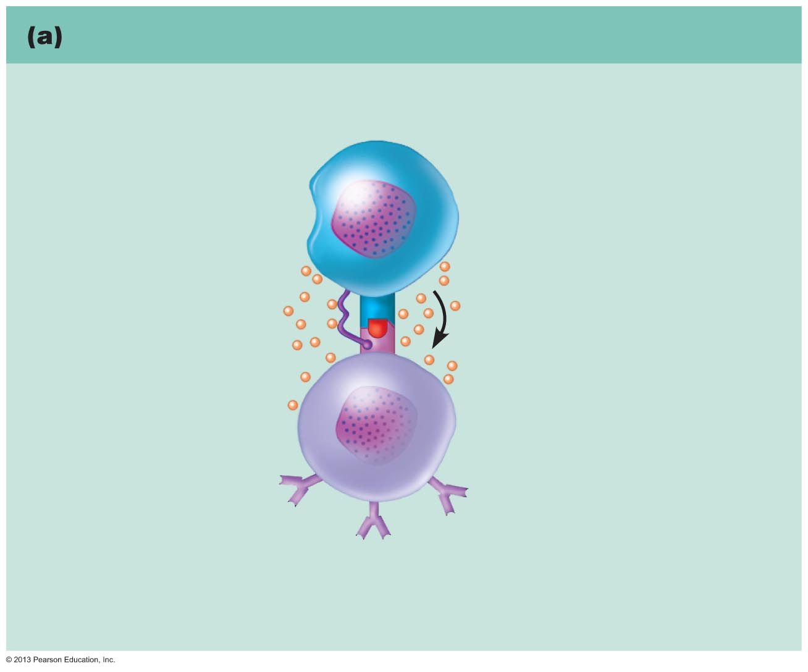
Figure 21.18a The central role of helper T cells in mobilizing both humoral and cellular immunity. Slide 1
Helper T cells help in humoral immunity
Helper T cell
1
T_{H} cell binds
with the self-nonself
complexes of a B cell
that has encountered
its antigen and is
displaying it on
MHC II on its surface.
T cell receptor (TCR)
Helper T cell
CD4 protein
MHC II protein
of B cell displaying
processed antigen
2
T_{H} cell releases interleukins as co-
stimulatory signals to complete B cell activation.
IL-4 and other
cytokines
B cell (being activated)

Slide 60
Helper T cells: Activation of CD8 cells
CD8 cells require T_{H} cell activation into destructive cytotoxic T cells
Cause dendritic cells to express co-stimulatory molecules required for CD8 cell activation

Slide 61
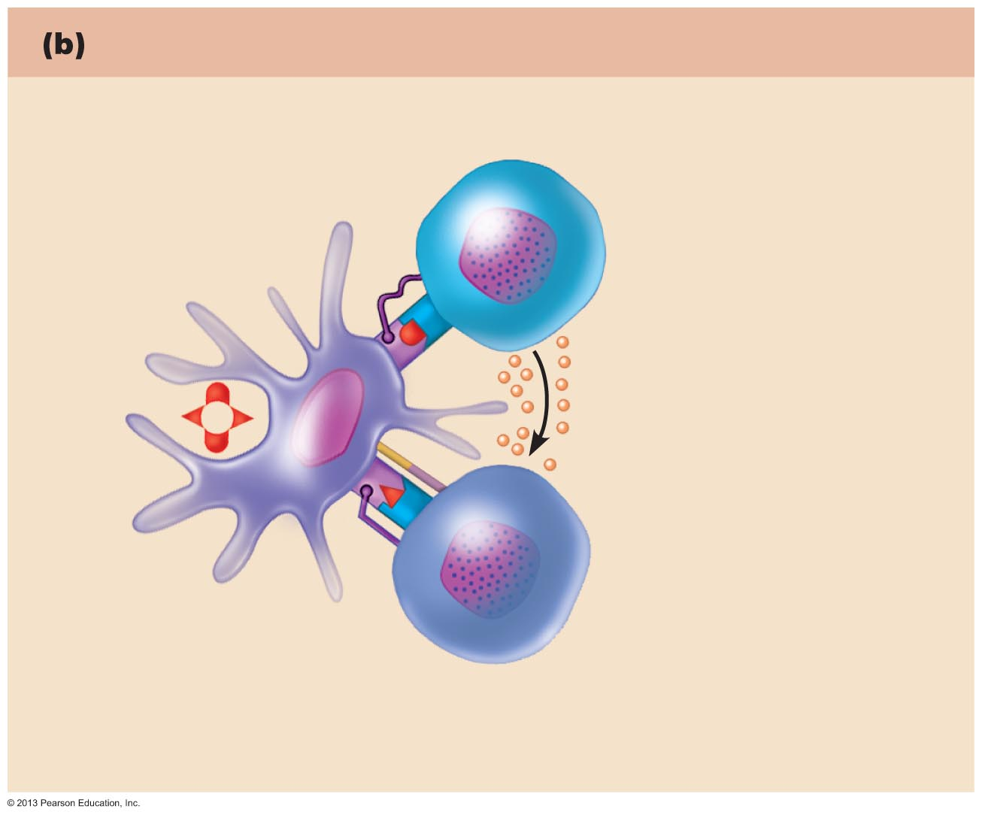
Figure 21.18b The central role of helper T cells in mobilizing both humoral and cellular immunity.
Slide 1
Helper T cells help in cellular immunity
CD4 protein
Helper T cell
1
Class II MHC
protein
T_{H} cell binds
dendritic cell.
APC (dendritic cell)
T_{H} cell
stimulates dendritic
cell to express
co-stimulatory
molecules.
2
IL-2
Dendritic cell
can now activate
CD8 cell with the
help of interleukin 2
secreted by T_{H} cell.
3
Class I
MHC protein
CD8
protein
CD8 T cell
(becomes T_{C} cell
after activation)

Slide 62
Helper T cells: Amplification of Innate Defenses
Amplify responses of innate immune system
Activate macrophages → more potent killers
Mobilize lymphocytes and macrophages and attract other types of WBCs

Slide 63
Helper T cells: Subsets of T_{H} cells
T_{H}1 – mediate most aspects of cellular immunity
T_{H}2 – defend against parasitic worms; mobilize eosinophils; promote allergies
T_{H}17 – link adaptive and innate immunity by releasing IL-17; may play role in autoimmune disease

Slide 64
Cytotoxic T (T_{C}) cells
Directly attack and kill other cells
Activated T_{C} cells circulate in blood and lymph and lymphoid organs in search of body cells displaying antigen they recognize

Slide 65
Roles of Cytotoxic T (T_{C}) cells
Targets
Virus-infected cells
Cells with intracellular bacteria or parasites
Cancer cells
Foreign cells (transfusions or transplants)

Slide 66
Cytotoxic T cells
Lethal hit – two methods:
T_{C} cell releases perforins and granzymes by exocytosis
Perforins create pores through which granzymes enter target cell
Granzymes stimulate apoptosis
T_{C} cell binds specific membrane receptor on target cell, and stimulates apoptosis

Slide 67
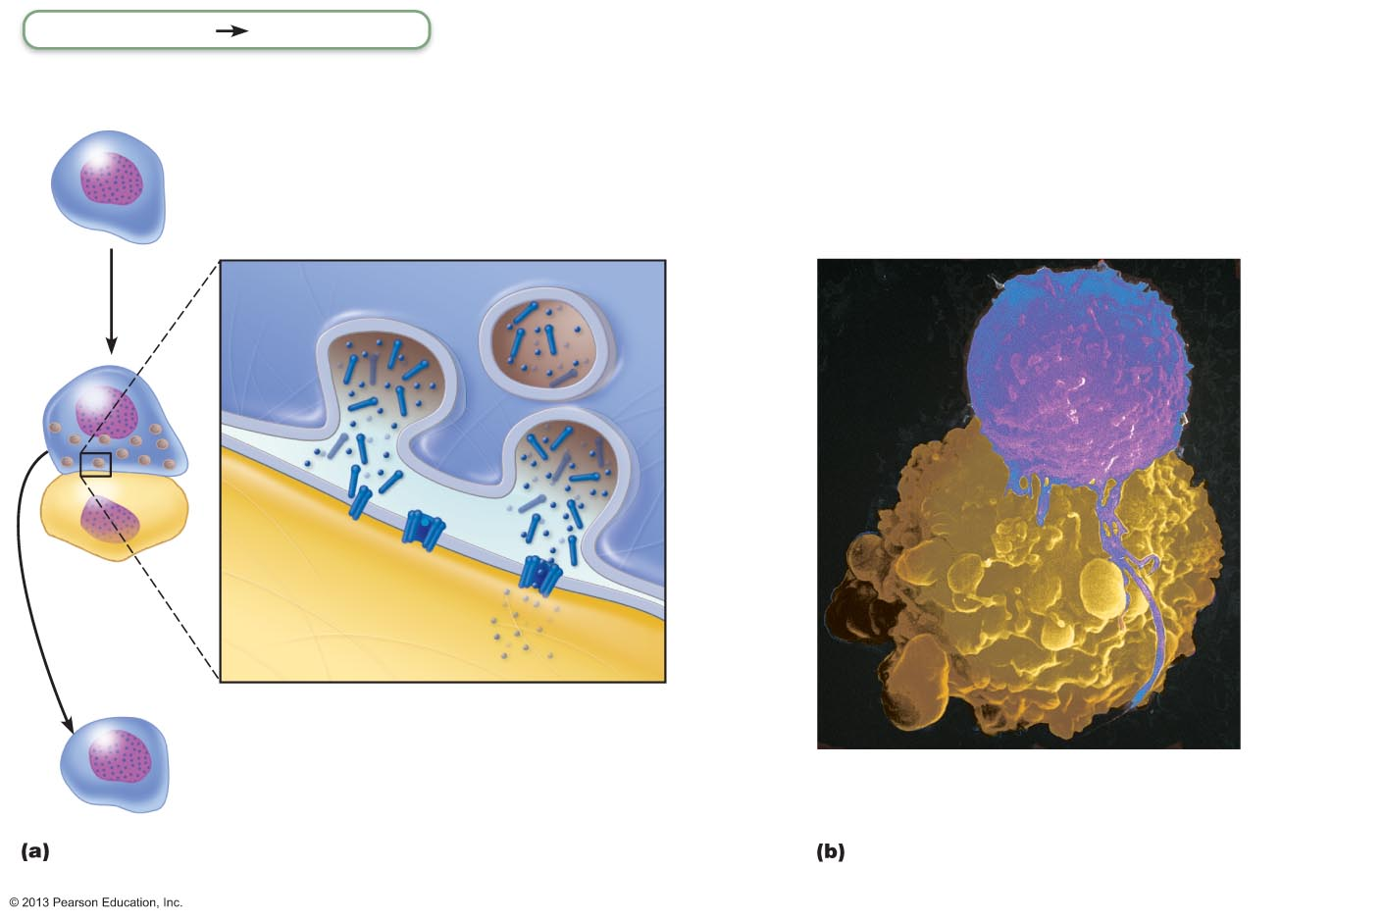
Figure 21.19 Cytotoxic T cells attack infected and cancerous cells.
Adaptive defenses
Cellular immunity
Cytotoxic
T cell (T_{C})
T_{C} identifies foreign antigens on MHC I proteins and binds tightly to target cell.
T_{C} releases perforin and granzyme molecules from its granules by exocytosis.
3
1
2
Perforin molecules insert into
the target cell membrane, polymerize, and form transmembrane pores (cylindrical holes) similar to those produced by complement activation.
Perforin
Granule
T_{C} cell
membrane
Cytotoxic
T cell
Target
cell
membrane
Target
cell
Perforin
pore
Cancer cell
Granzymes
4
The T_{C} detaches
and searches for
another prey.
Granzymes enter the
target cell via the pores.
Once inside, granzymes
activate enzymes that
trigger apoptosis.
5
A mechanism of target cell killing by T_{C} cells.
Scanning electron micrograph of a
T_{C} cell killing a cancer cell (2100x).

Slide 68
Natural Killer cells
Recognize other signs of abnormality
Lack of class I MHC
Antibody coating target cell
Different surface markers of stressed cells
Use same key mechanisms as T_{C} cells for killing their target cells
Immune surveillance—NK and T_{C} cells prowl for markers they recognize

Slide 69
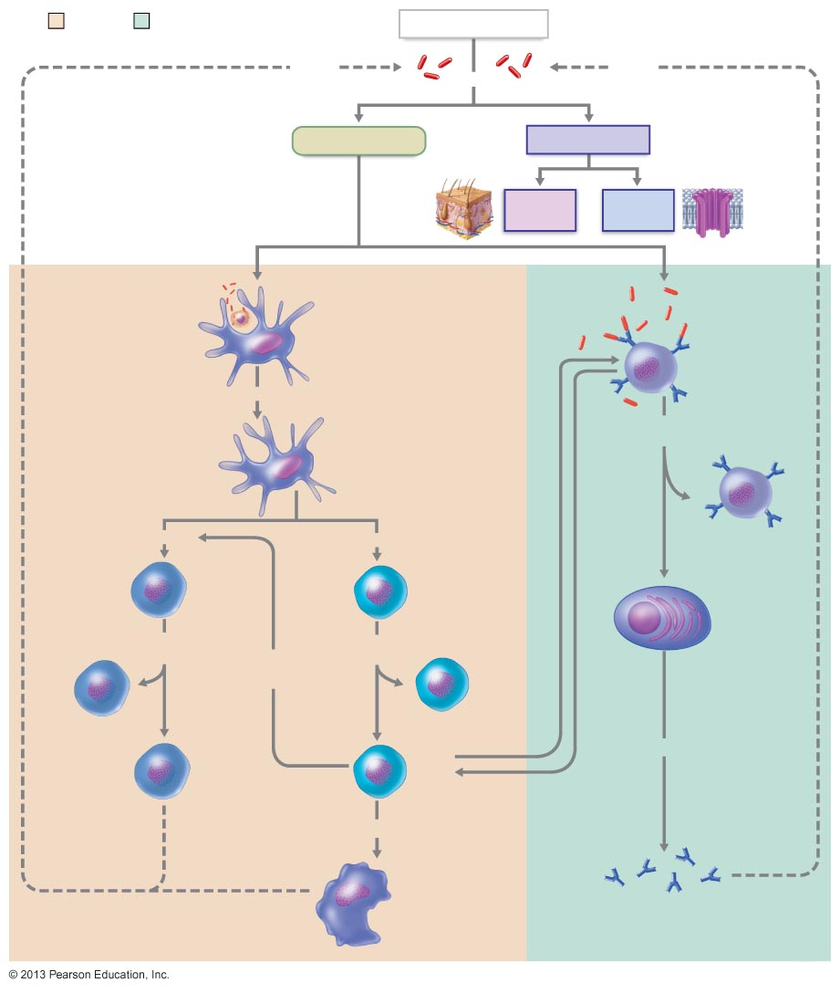
Figure 21.20 Simplified summary of the primary immune response.
Cellular
immunity
Humoral
immunity
Antigen (Ag) intruder
Inhibits
Triggers
Inhibits
Adaptive defenses
Innate defenses
Surface
barriers
Internal
defenses
Free Ags
may directly
activate B cell
Ag-infected
body cell engulfed
by dendritic cell
Antigen-
activated
B cells
Becomes
Clone and
give rise to
Ag-presenting cell
(APC) presents
self-Ag complex
Present Ag to activated helper T cells
Activates
Activates
Co-stimulate and release cytokines
Memory
B cells
Naive
CD8
T cells
Naive
CD4
T cells
Activated to clone
and give rise to
Activated to clone
and give rise to
Memory
CD8
T cells
Induce
co-stimulation
Memory
CD4
T cells
Plasma cells
(effector B cells)
Cytotoxic
T cells
Helper
T cells
Secrete
Cytokines stimulate
Together the nonspecific killers
and cytotoxic T cells mount a
physical attack on the Ag
Nonspecific killers
(macrophages and
NK cells of innate
immunity)
Antibodies (Igs)
Circulating lgs along with complement
mount a chemical attack on the Ag

Slide 70
Organ Transplants
Four varieties
Autografts: from one body site to another in same person
Isografts: between identical twins
Allografts: between individuals who are not identical twins
Xenografts: from another animal species

Slide 71
Organ Transplants
Success depends on similarity of tissues
Autografts and isografts ideal donor tissues
Almost always successful if good blood supply and no infection
Research into successful xenografts from genetically engineered animals
Most common is allograft
ABO, other blood antigens, MHC antigens matched as closely as possible

Slide 72
Prevention of Rejection
After surgery
Patient treated with immunosuppressive therapy
Corticosteroid drugs to suppress inflammation
Antiproliferative drugs
Immunosuppressant drugs
Many of these have severe side effects

Slide 73
Immunosuppressive Therapy Problems
Patient's immune system suppressed
Cannot protect from foreign agents
Bacterial and viral infections → death
Must balance drugs for graft survival but no toxicity
Use antibiotics to control infections
Best circumstances – rejection after 10 years in 50% of patients

Slide 74
Immunosuppressive Therapy Problems
Research to induce tolerance
Chimeric immune system
Suppress recipient's bone marrow
Douse recipient's bone marrow with bone marrow from donor of new organ
"Combined" immune system may treat transplanted organ as self
Harness regulatory T cell to suppress immune reactions

Slide 75
Immunodeficiencies
Congenital or acquired conditions that impair function or production of immune cells or molecules such as complement or antibodies

Slide 76
Congenital Immunodeficiencies
Severe Combined Immunodeficiency (SCID) Syndrome - genetic defect
Marked deficit in B and T cells
Defective adenosine deaminase (ADA) enzyme
Metabolites lethal to T cells accumulate
Fatal if untreated; treated with bone marrow transplants

Slide 77
Hodgkin's Disease
Acquired immunodeficiency
Cancer of B cells
Leads to immunodeficiency by depressing lymph node cells

Slide 78
Acquired Immune Deficiency Syndrome (AIDS)
Cripples immune system by interfering with activity of helper T cells
Characterized by severe weight loss, night sweats, and swollen lymph nodes
Opportunistic infections occur, including pneumocystis pneumonia and Kaposi's sarcoma

Slide 79
Acquired Immune Deficiency Syndrome (AIDS)
Caused by human immunodeficiency virus (HIV) transmitted via body fluids—blood, semen, and vaginal secretions
HIV enters the body via
Blood transfusions; blood-contaminated needles; sexual intercourse and oral sex; mother to fetus
HIV
Destroys T_{H} cells → depresses cellular immunity

Slide 80
Treatment of Autoimmune Diseases
Suppress entire immune system
Anti-inflammatory drugs, e.g., corticosteroids
Blocking cytokine action
Blocking co-stimulatory molecules
Research
Activating regulatory T cells; inducing self-tolerance using vaccines; directing antibodies against self-reactive immune cells

Slide 81
Immediate Hypersensitivity
Acute (type I) hypersensitivities (allergies) begin in seconds after contact with allergen
Initial contact is asymptomatic but sensitizes person
Reaction may be local or systemic

Slide 82
Anaphylactic Shock
Systemic response to allergen that directly enters blood and circulates rapidly
Basophils and mast cells enlisted throughout body
Systemic histamine release may cause
Constriction of bronchioles; tongue may swell
Sudden vasodilation and fluid loss from bloodstream may →
Circulatory collapse (hypotensive shock) and death
Treatment: epinephrine

Slide 83
Just extra outline from TEXT not covered in class

Slide 84
Class I MHC Proteins
Bind with fragment of protein synthesized in the cell (endogenous antigen)
Endogenous antigen is self-antigen in normal cell; a nonself antigen in infected or abnormal cell
Crucial for CD8 cell activation
Inform cytotoxic T cells of microorganisms hiding in cells (cytotoxic T cells ignore displayed self-antigens)
Act as antigen holders; form "self" part that T cells recognize

Slide 85
Class II MHC Proteins
Bind with fragments of exogenous antigens that have been engulfed and broken down in a phagolysosome
Recognized by helper T cells
Signal CD4 cells that help is required

Slide 86
MHC Restriction
CD4 and CD8 cells have different requirements for MHC protein that presents antigens to them
CD4 cells that become T_{H} – bind only class II MHC proteins typically on APC surfaces
CD8 cells that become cytotoxic T cells – bind only class I MHC proteins on APC surfaces
Once activated, cytotoxic T cells seek same antigen on class I MHC proteins on any cell

Slide 87
MHC Restriction
CD8 cells activated by class I MHC proteins
How do APCs get endogenous antigens from another cell and display them on class I MHCs?
Dendritic cells engulf dying virus-infected or tumor cells, or import antigens via temporary gap junctions with infected cells—then display both class I and class II MHCs

Slide 88
Antigen-presenting Cells (APCs)
Engulf antigens
Present fragments of antigens to T cells for recognition
Major types
Dendritic cells in connective tissues and epidermis
Macrophages in connective tissues and lymphoid organs
B cells

Slide 89
Dendritic Cells and Macrophages
Dendritic cells phagocytize pathogens, enter lymphatics to present antigens to T cells in lymph node
Most effective antigen presenter known
Key link between innate and adaptive immunity
Macrophages widespread in lymphoid organs and connective tissues
Present antigens to T cells to activate themselves into voracious phagocytes that secrete bactericidal chemicals

Slide 90
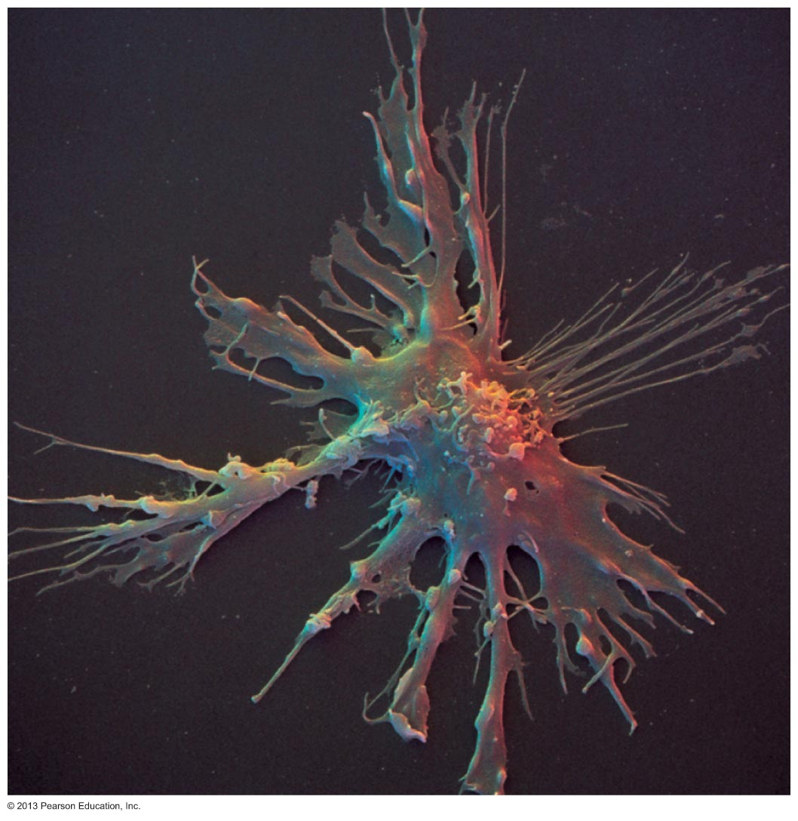
Figure 21.10 Dendritic cell. Scanning electron micrograph (1050x).

Slide 91
B lymphocytes
Do not activate naive T cells
Present antigens to helper T cell to assist own activation

Slide 92
Adaptive Immunity: Summary
Uses lymphocytes, APCs, and specific molecules to identify and destroy nonself substances
Depends upon ability of its cells to
Recognize antigens by binding to them
Communicate with one another so that whole system mounts specific response

Slide 93
Activation and Differentiation of B Cells
B cell activated when antigens bind to its surface receptors and cross-link them →
Receptor-mediated endocytosis of cross-linked antigen-receptor complexes (clonal selection) →
Proliferation and differentiation into effector cells

Slide 94
Fate of the Clones
Most clone cells become plasma cells
Secrete specific antibodies at rate of 2000 molecules per second for four to five days, then die
Antibodies circulate in blood or lymph
Bind to free antigens and mark for destruction by innate or adaptive mechanisms

Slide 95
Fate of the Clones
Clone cells that do not become plasma cells become memory cells
Provide immunological memory
Mount an immediate response to future exposures to same antigen

Slide 96
Neutralization
Simplest defensive mechanism
Antibodies block specific sites on viruses or bacterial exotoxins
Prevent these antigens from binding to receptors on tissue cells
Antigen-antibody complexes undergo phagocytosis

Slide 97
Agglutination
Antibodies bind same determinant on more than one cell-bound antigen
Cross-linked antigen-antibody complexes agglutinate
Example: clumping of mismatched blood cells

Slide 98
Precipitation
Soluble molecules are cross-linked
Complexes precipitate and are subject to phagocytosis

Slide 99
Complement Fixation and Activation
Main antibody defense against cellular antigens (bacteria, mismatched RBCs)
Several antibodies bind close together on a cellular antigen → complement-binding sites on stem regions align
Triggers complement fixation into cell's surface
→ Cell lysis

Slide 100
Complement Fixation and Activation
Activated complement functions
Amplifies inflammatory response
Promotes phagocytosis via opsonization
→ Positive feedback cycle that enlists more and more defensive elements

Slide 101
Basic Antibody Structure
T- or Y-shaped antibody monomer of four looping polypeptide chains linked by disulfide bonds
Two identical heavy (H) chains with hinge region at "middles"
Two identical light (L) chains
Variable (V) regions at one end of each arm combine to form two identical antigen-binding sites

Slide 102
Cytotoxic T cells
Bind to a self-nonself complex
Can destroy all infected or abnormal cells

Slide 103
Seeding Secondary Lymphoid Organs and Circulation
Immunocompetent B and T cells not yet exposed to antigen called naive
Exported from primary lymphoid organs (bone marrow and thymus) to "seed" secondary lymphoid organs (lymph nodes, spleen, etc.)
Increases chance of encounter with antigen

Slide 104
Monoclonal Antibodies as Clinical and Research Tools
Commercially prepared pure antibody
Specific for single antigenic determinant
Produced by hybridomas
Cell hybrids: fusion of tumor cell and B cell
Proliferate indefinitely and have ability to produce single type of antibody
Used in research, clinical testing, and cancer treatment

Slide 105
Summary of Antibody Actions
Antigen-antibody complexes do not destroy antigens; prepare them for destruction by innate defenses
Antibodies do not invade solid tissue unless lesion present
Can act intracellularly if attached to virus before it enters cell
Activate mechanisms that destroy virus

Slide 106
Cellular Immune Response
T cells provide defense against intracellular antigens
Some T cells directly kill cells; others release chemicals that regulate immune response

Slide 107
Cellular Immune Response
Two populations of T cells based on which glycoprotein surface receptors displayed
CD4 cells usually become helper T cells (T_{H}); activate B cells, other T cells, macrophages, and direct adaptive immune response
Some become regulatory T cells – which moderate immune response
Can also become memory T cells

Slide 108
Cellular Immune Response
CD8 cells become cytotoxic T cells (T_{C})
Destroy cells harboring foreign antigens
Also become memory T cells
Helper, cytotoxic, and regulatory T cells are activated T cells
Naive T cells simply termed CD4 or CD8 cells

Slide 109
MHC Proteins and Antigen Presentation
T cells respond only to processed fragments of antigens displayed on surfaces of cells
Antigen presentation vital for activation of naive T cells and normal functioning of effector T cells

Slide 110
MHC Proteins
Two types of MHC proteins important to T cell activation
Class I MHC proteins – displayed by all cells except RBCs
Class II MHC proteins – displayed by APCs (dendritic cells, macrophages, and B cells)
Both types are synthesized at ER and bind to peptide fragments

Slide 111
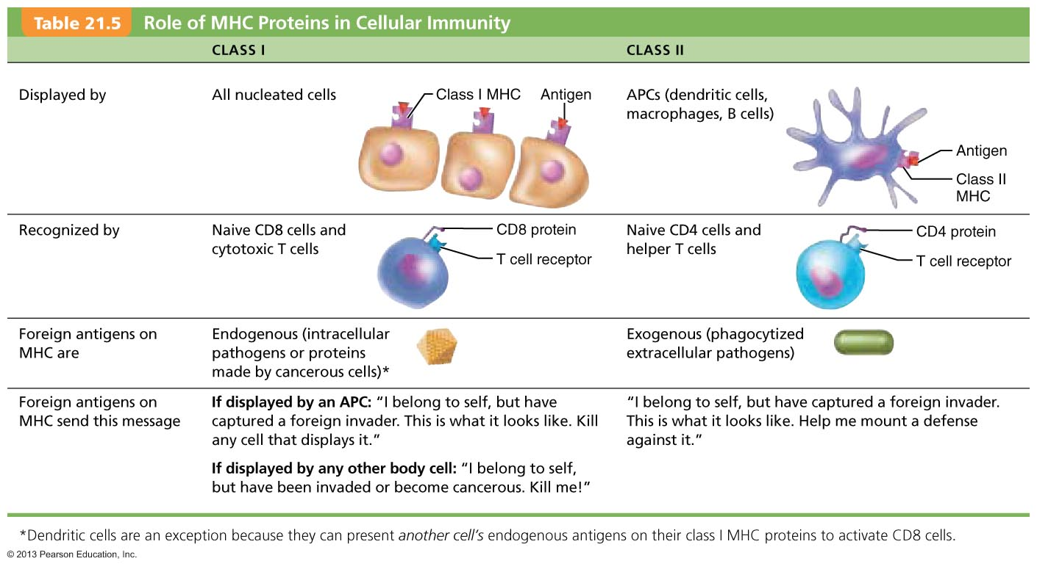
Table 21.5 Role of MHC Proteins in Cellular Immunity

Slide 112
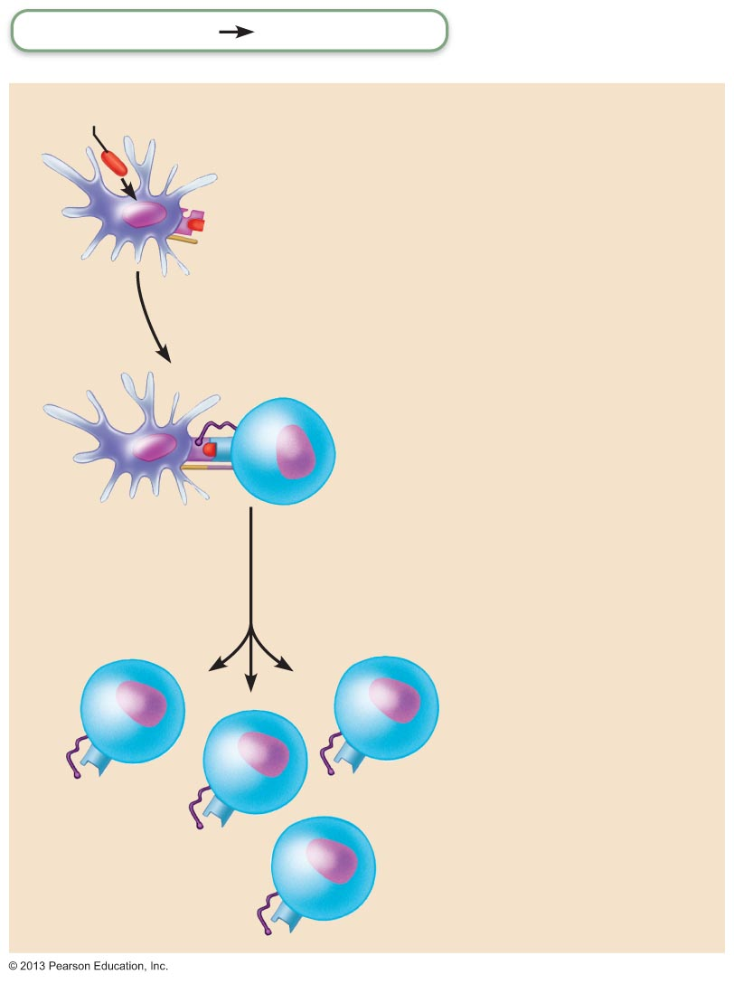
Figure 21.17 Clonal selection of T cells involves simultaneous recognition of self and nonself.
Slide 1
Adaptive defenses
Cellular immunity
Bacterial antigen
Antigen
presentation
Dendritic cell engulfs
an exogenous
antigen, processes it,
and displays its
fragments on class II
MHC protein.
1
Class lI MHC
protein
displaying
processed
bacterial antigen
Dendritic
cell
Co-stimulatory
molecule
CD4 protein
2
Double recognition
T cell
receptor
(TCR)
CD4 T cell
recognizes antigen-
MHC complex. Both
TCR and CD4 proteins
bind to antigen-MHC
complex.
2a
Co-stimulatory
molecules
CD4 T cell
Co-stimulatory
molecules bind
together.
2b
Clone
formation
Clone
formation Activated
CD4 T cells proliferate
(clone), and become
memory and effector
cells.
3
Memory
CD4 T cell
Helper
T cells

Slide 113
Acquired Immune Deficiency Syndrome (AIDS)
HIV multiplies in lymph nodes throughout asymptomatic period, ~10 years if untreated
Symptoms when immune system collapses
Virus also invades brain → dementia
HIV-coated glycoprotein complex attaches to CD4 receptor
HIV enters cell and uses reverse transcriptase to produce DNA from its viral RNA
The DNA copy (a provirus) directs host cell to make viral RNA and proteins, enabling virus to reproduce

Slide 114
Acquired Immune Deficiency Syndrome (AIDS)
HIV reverse transcriptase → frequent errors; high mutation rate and resistance to drugs
Treatment with antiviral drugs
Fusion inhibitors block HIV's entry into cell
Integrase inhibitors block viral RNA integration into host's DNA
Reverse transcriptase and protease inhibitors inhibit viral replication enzymes
Antiretroviral vaginal gel reduces risk by 50%

Slide 115
Autoimmune Diseases
Immune system loses ability to distinguish self from foreign
Production of autoantibodies and sensitized T_{C} cells that destroy body tissues
Examples include multiple sclerosis, myasthenia gravis, Graves' disease, type 1 diabetes mellitus, systemic lupus erythematosus (SLE), glomerulonephritis, and rheumatoid arthritis

Slide 116
In adaptive immunity, receptors provide pathogen-specific recognition
The adaptive response relies on two types of lymphocytes, or white blood cells
Lymphocytes that mature in the thymus above the heart are called T cells, and those that mature in bone marrow are called B cells
© 2011 Pearson Education, Inc.

Slide 117
Antigens are substances that can elicit a response from a B or T cell
Exposure to the pathogen activates B and T cells with antigen receptors specific for parts of that pathogen
The small accessible part of an antigen that binds to an antigen receptor is called an epitope
© 2011 Pearson Education, Inc.

Slide 118
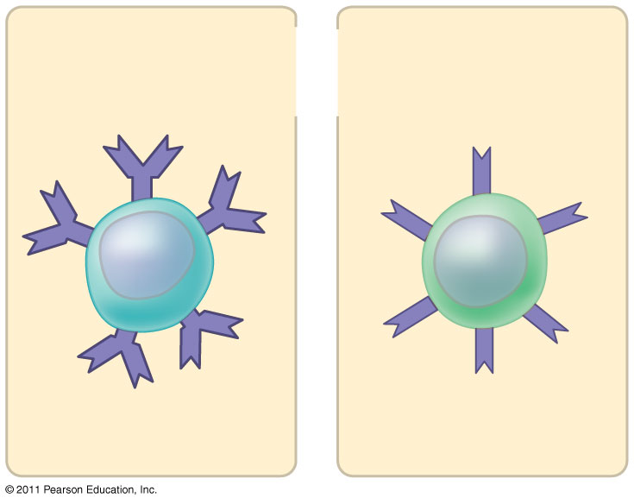
Figure 43.UN01
Antigen receptors
Mature B cell
Mature T cell
Notes:
Figure 43.UN01 In-text figure, p. 935

Slide 119
B cells and T cells have receptor proteins that can bind to foreign molecules
Each individual lymphocyte is specialized to recognize a specific type of molecule
© 2011 Pearson Education, Inc.

Slide 120
Antigen Recognition by B Cells and Antibodies
Each B cell antigen receptor is a Y-shaped molecule with two identical heavy chains and two identical light chains
The constant regions of the chains vary little among B cells, whereas the variable regions differ greatly
The variable regions provide antigen specificity
© 2011 Pearson Education, Inc.

Slide 121
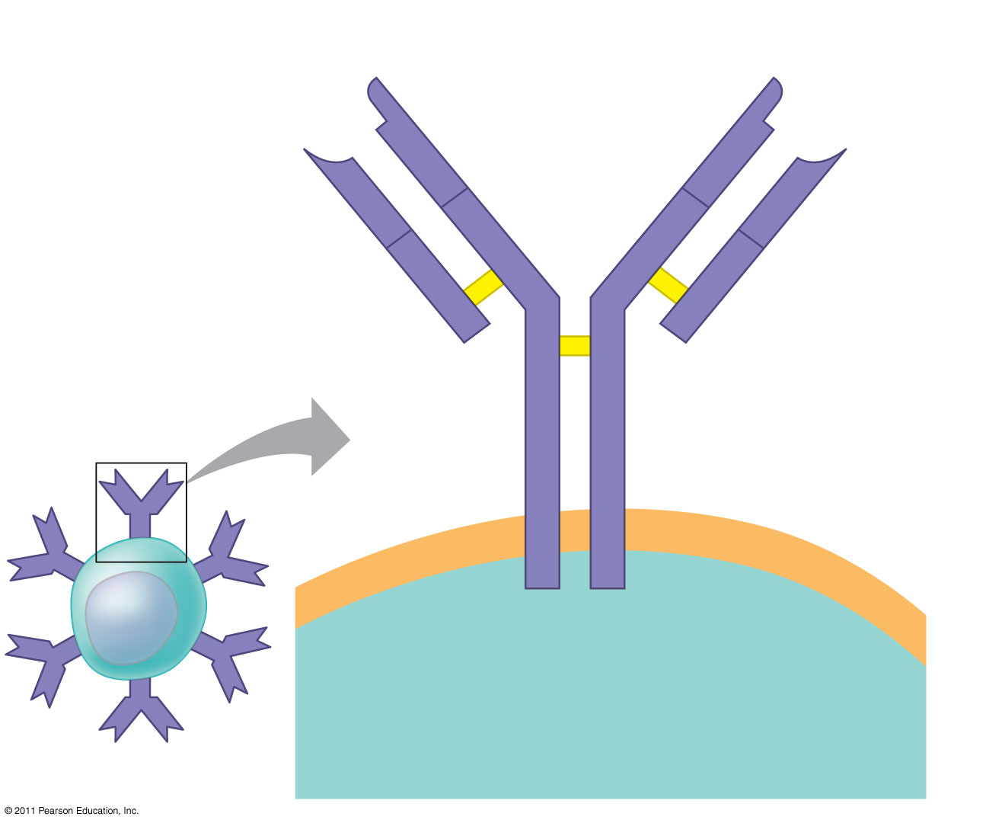
Figure 43.9
Antigen- binding site
Antigen- binding site
V
Disulfide bridge
V
V
V
Variable regions
C
C
B cell antigen receptor
Constant regions
C
C
Light chain
Transmembrane region
Heavy chains
Plasma membrane
B cell
Cytoplasm of B cell
Notes:
Figure 43.9 The structure of a B cell antigen receptor.

Slide 122
Binding of a B cell antigen receptor to an antigen is an early step in B cell activation
This gives rise to cells that secrete a soluble form of the protein called an antibody or immunoglobulin (Ig)
Secreted antibodies are similar to B cell receptors but lack transmembrane regions that anchor receptors in the plasma membrane
© 2011 Pearson Education, Inc.

Slide 123
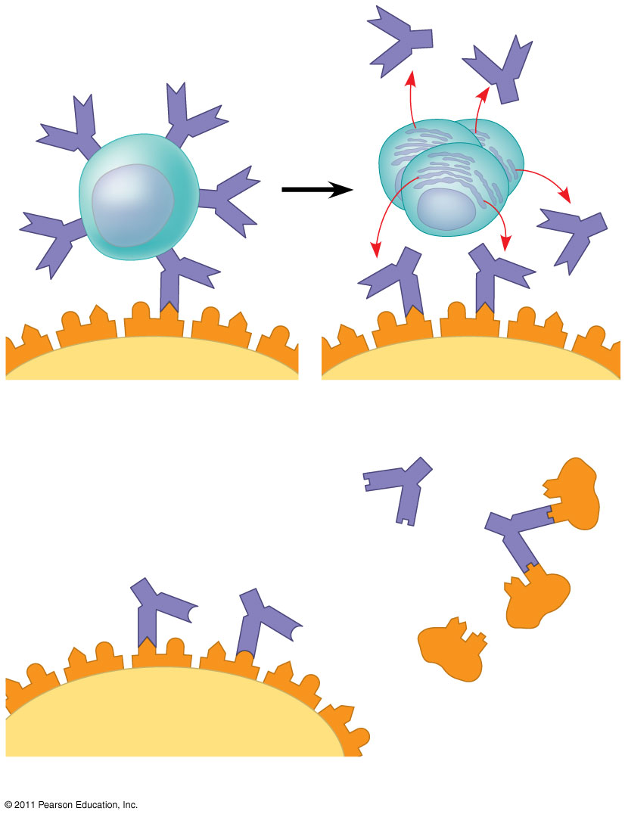
Figure 43.10
Antigen receptor
Antibody
B cell
Antigen
Epitope
Pathogen
(a) B cell antigen receptors and antibodies
Antibody C
Antibody A
Antibody B
Antigen
(b) Antigen receptor specificity
Notes:
Figure 43.10 Antigen recognition by B cells and antibodies.

Slide 124
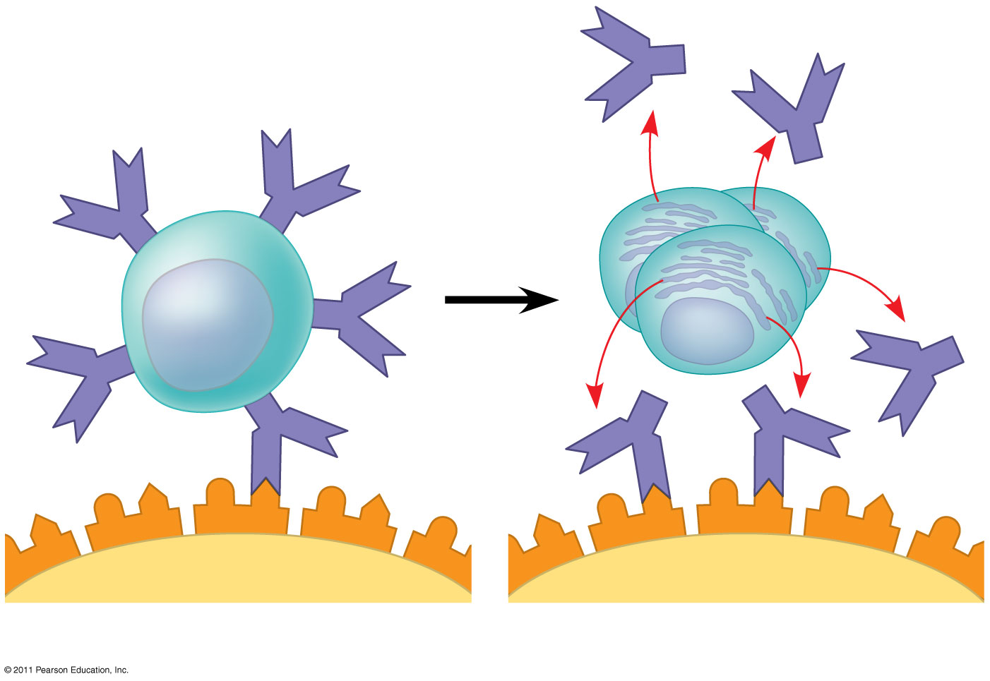
Figure 43.10a
Antigen receptor
Antibody
B cell
Antigen
Epitope
Pathogen
(a) B cell antigen receptors and antibodies
Notes:
Figure 43.10 Antigen recognition by B cells and antibodies.

Slide 125
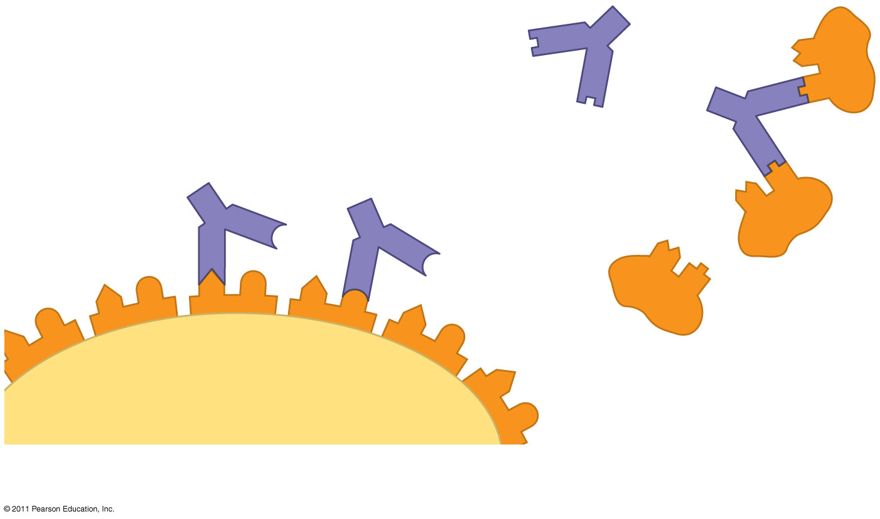
Figure 43.10b
Antibody C
Antibody A
Antibody B
Antigen
(b) Antigen receptor specificity
Notes:
Figure 43.10 Antigen recognition by B cells and antibodies.

Slide 126
Antigen Recognition by T Cells
Each T cell receptor consists of two different polypeptide chains (called α and β)
The tips of the chain form a variable (V) region; the rest is a constant (C) region
T cell and B cell antigen receptors are functionally different
Video: T Cell Receptors
© 2011 Pearson Education, Inc.

Slide 127
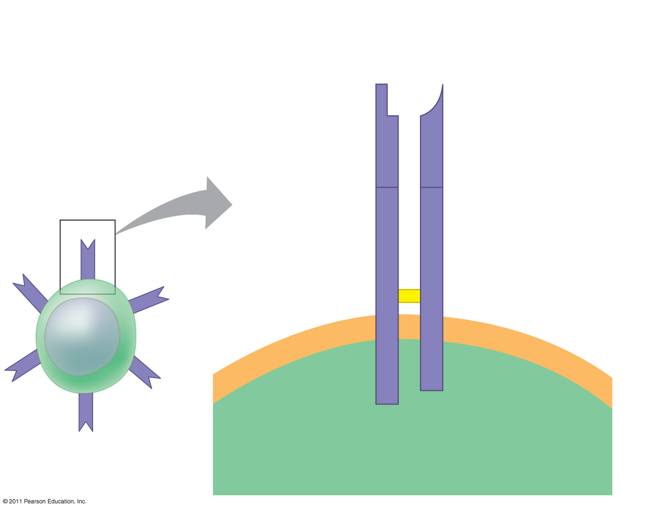
Figure 43.11
Antigen- binding site
T cell antigen receptor
Variable regions
V
V
C
C
Constant regions
Disulfide bridge
Transmembrane region
α chain
β chain
Plasma membrane
T cell
Cytoplasm of T cell
Notes:
Figure 43.11 The structure of a T cell antigen receptor.

Slide 128
T cells bind to antigen fragments displayed or presented on a host cell
These antigen fragments are bound to cell-surface proteins called MHC molecules
MHC (major histocompatibility complex) molecules are host proteins that display the antigen fragments on the cell surface
© 2011 Pearson Education, Inc.

Slide 129
In infected cells, MHC molecules bind and transport antigen fragments to the cell surface, a process called antigen presentation
A T cell can then bind both the antigen fragment and the MHC molecule
This interaction is necessary for the T cell to participate in the adaptive immune response
© 2011 Pearson Education, Inc.

Slide 130
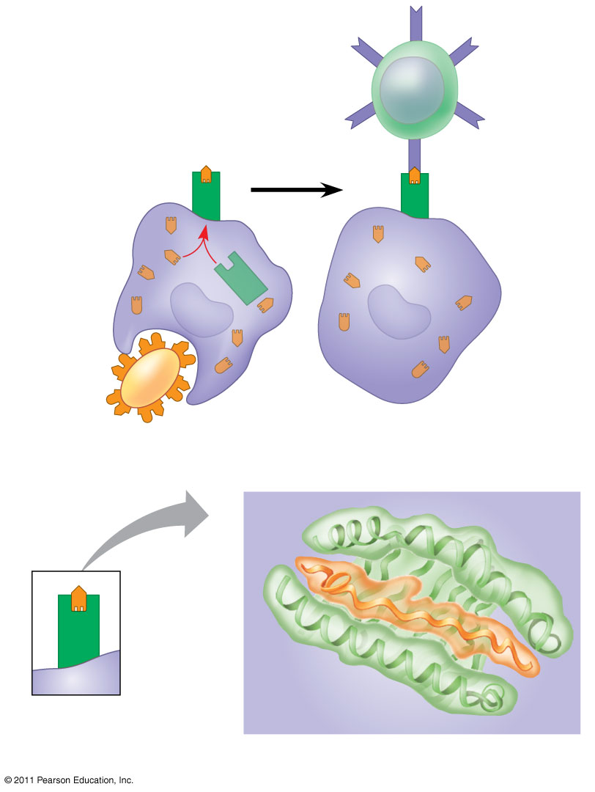
Figure 43.12
Displayed antigen fragment
T cell
MHC molecule
T cell antigen receptor
Antigen fragment
Pathogen
Host cell
(a) Antigen recognition by a T cell
Top view
Antigen fragment
MHC molecule
Host cell
(b) A closer look at antigen presentation
Notes:
Figure 43.12 Antigen recognition by T cells.

Slide 131
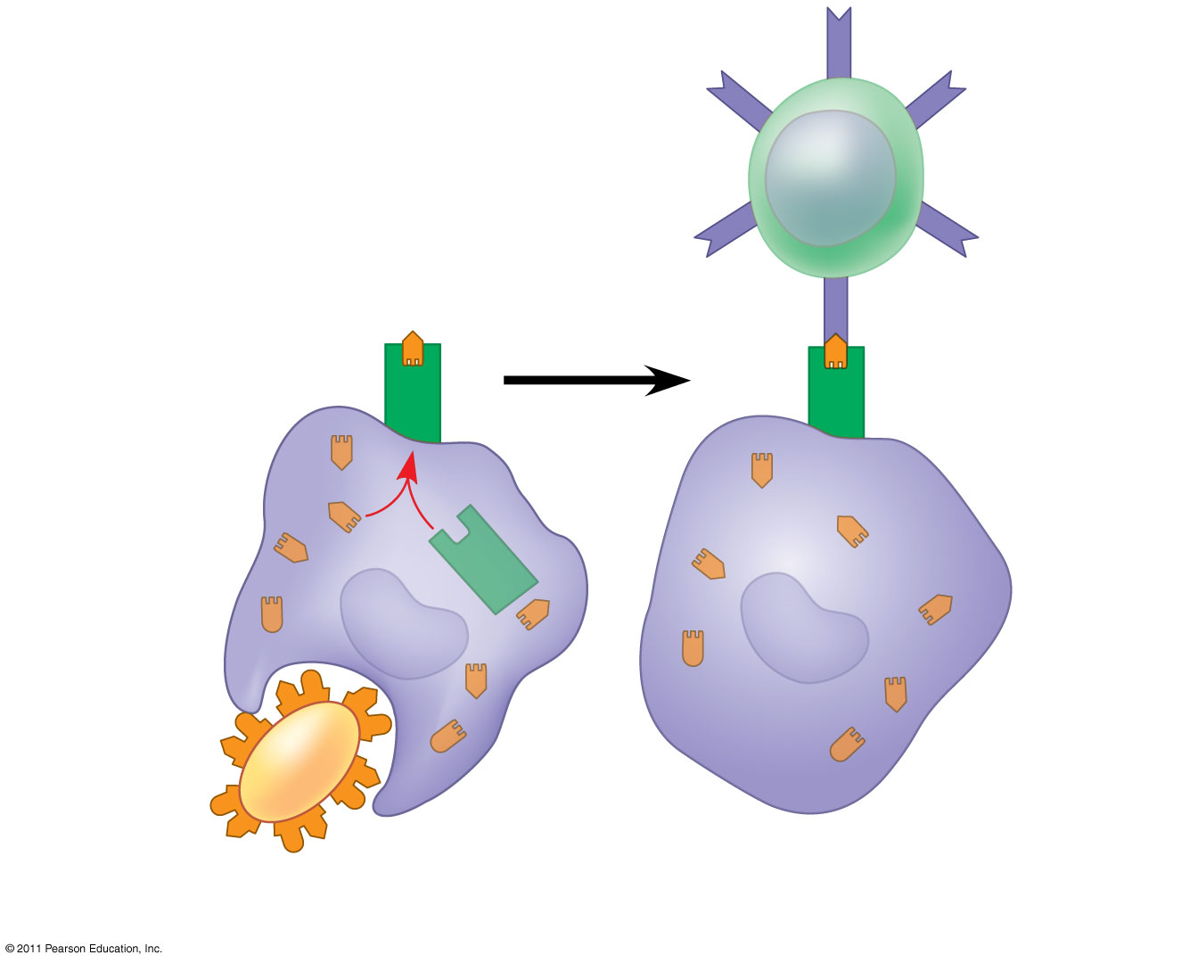
Figure 43.12a
Displayed antigen fragment
T cell
T cell antigen receptor
MHC molecule
Antigen fragment
Pathogen
Host cell
(a) Antigen recognition by a T cell
Notes:
Figure 43.12 Antigen recognition by T cells.

Slide 132
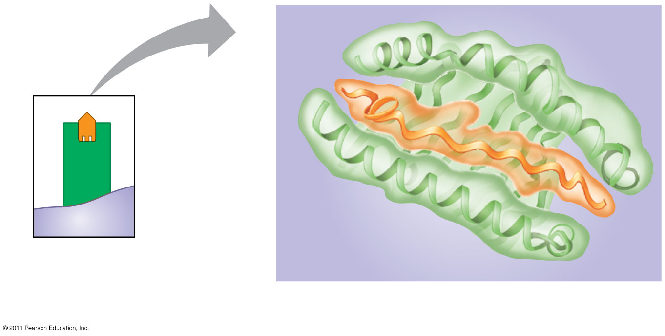
Figure 43.12b
Top view
Antigen fragment
MHC molecule
Host cell
(b) A closer look at antigen presentation
Notes:
Figure 43.12 Antigen recognition by T cells.

Slide 133
B Cell and T Cell Development
The adaptive immune system has four major characteristics
Diversity of lymphocytes and receptors
Self-tolerance; lack of reactivity against an animal’s own molecules
B and T cells proliferate after activation
Immunological memory
© 2011 Pearson Education, Inc.

Slide 134
Generation of B and T Cell Diversity
By combining variable elements, the immune system assembles a diverse variety of antigen receptors
The immunoglobulin (Ig) gene encodes one chain of the B cell receptor
Many different chains can be produced from the same gene by rearrangement of the DNA
Rearranged DNA is transcribed and translated and the antigen receptor formed
© 2011 Pearson Education, Inc.

Slide 135
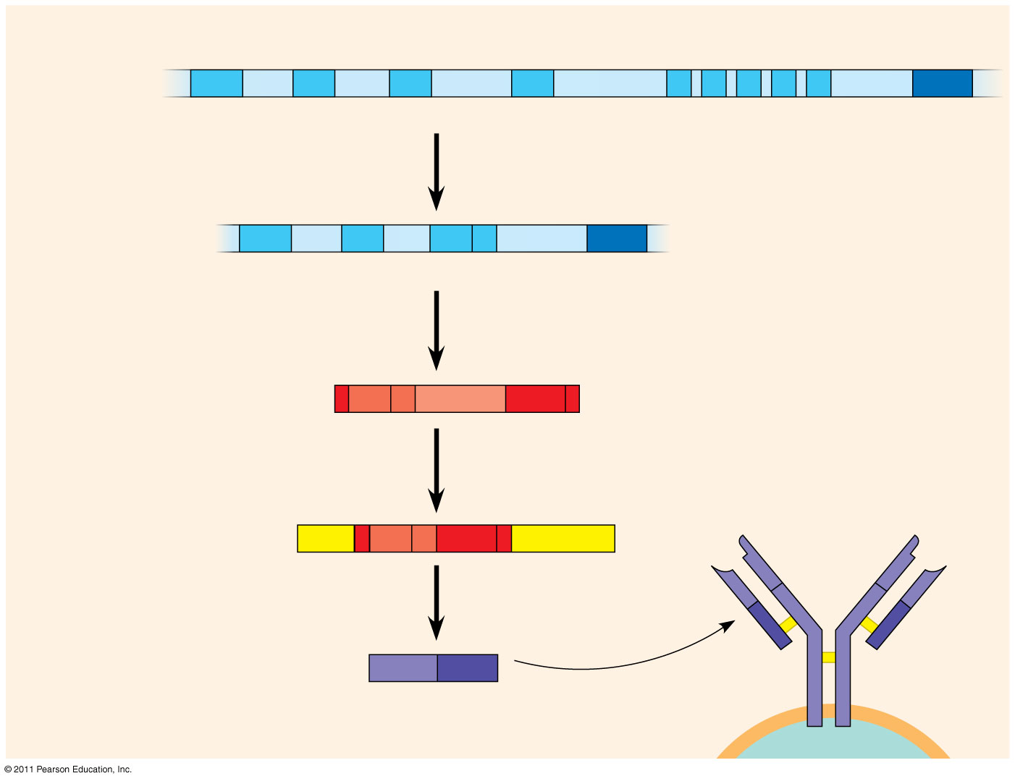
Figure 43.13
DNA of undifferentiated B cell
V₃₇
V₃₈
V₃₉
V₄₀
J₁
J₂
J₃
J₄
J₅
Intron
C
1
Recombination deletes DNA between randomly selected V segment and J segment
DNA of differentiated B cell
V₃₇
V₃₈
V₃₉
J₅
Intron
C
Functional gene
2
Transcription
pre-mRNA
V₃₉
J₅
Intron
C
3
RNA processing
mRNA
Cap
V₃₉
J₅
C
Poly-A tail
V
V
4
Translation
V
V
C
C
Light-chain polypeptide
V
C
C
C
Antigen receptor
Variable region
Constant region
B cell
Notes:
Figure 43.13 Immunoglobulin (antibody) gene rearrangement.

Slide 136
Origin of Self-Tolerance
Antigen receptors are generated by random rearrangement of DNA
As lymphocytes mature in bone marrow or the thymus, they are tested for self-reactivity
Some B and T cells with receptors specific for the body’s own molecules are destroyed by apoptosis, or programmed cell death
The remainder are rendered nonfunctional
© 2011 Pearson Education, Inc.

Slide 137
Proliferation of B Cells and T Cells
In the body there are few lymphocytes with antigen receptors for any particular epitope
In the lymph nodes, an antigen is exposed to a steady stream of lymphocytes until a match is made
This binding of a mature lymphocyte to an antigen initiates events that activate the lymphocyte
© 2011 Pearson Education, Inc.

Slide 138
Once activated, a B or T cell undergoes multiple cell divisions
This proliferation of lymphocytes is called clonal selection
Two types of clones are produced: short-lived activated effector cells that act immediately against the antigen and long-lived memory cells that can give rise to effector cells if the same antigen is encountered again
© 2011 Pearson Education, Inc.

Slide 139
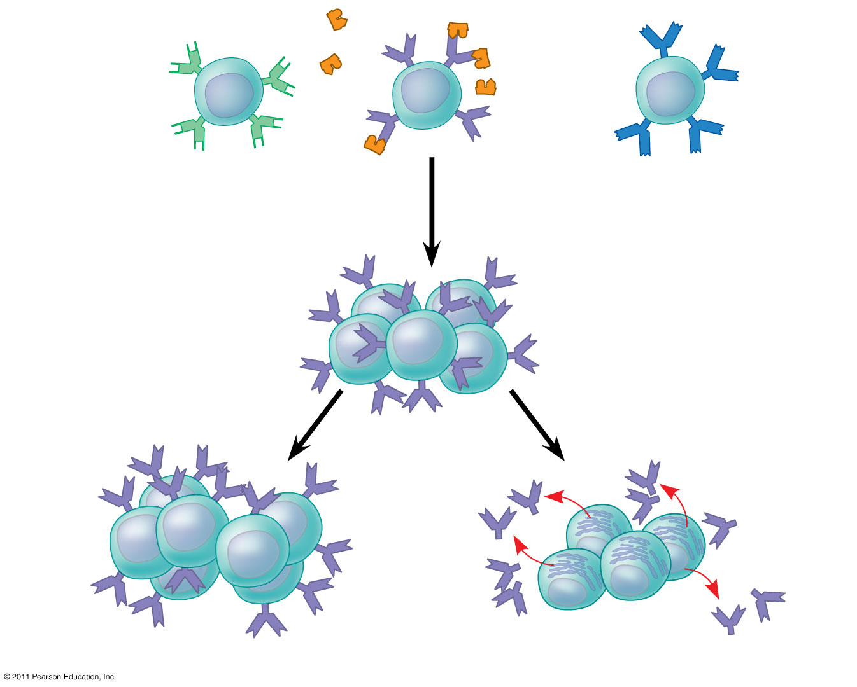
Figure 43.14
B cells that differ in antigen specificity
Antigen
Antigen receptor
Antibody
Memory cells
Plasma cells
Notes:
Figure 43.14 Clonal selection.

Slide 140
Immunological Memory
Immunological memory is responsible for long-term protections against diseases, due to either a prior infection or vaccination
The first exposure to a specific antigen represents the primary immune response
During this time, selected B and T cells give rise to their effector forms
In the secondary immune response, memory cells facilitate a faster, more efficient response
Animation: Role of B Cells
© 2011 Pearson Education, Inc.

Slide 141
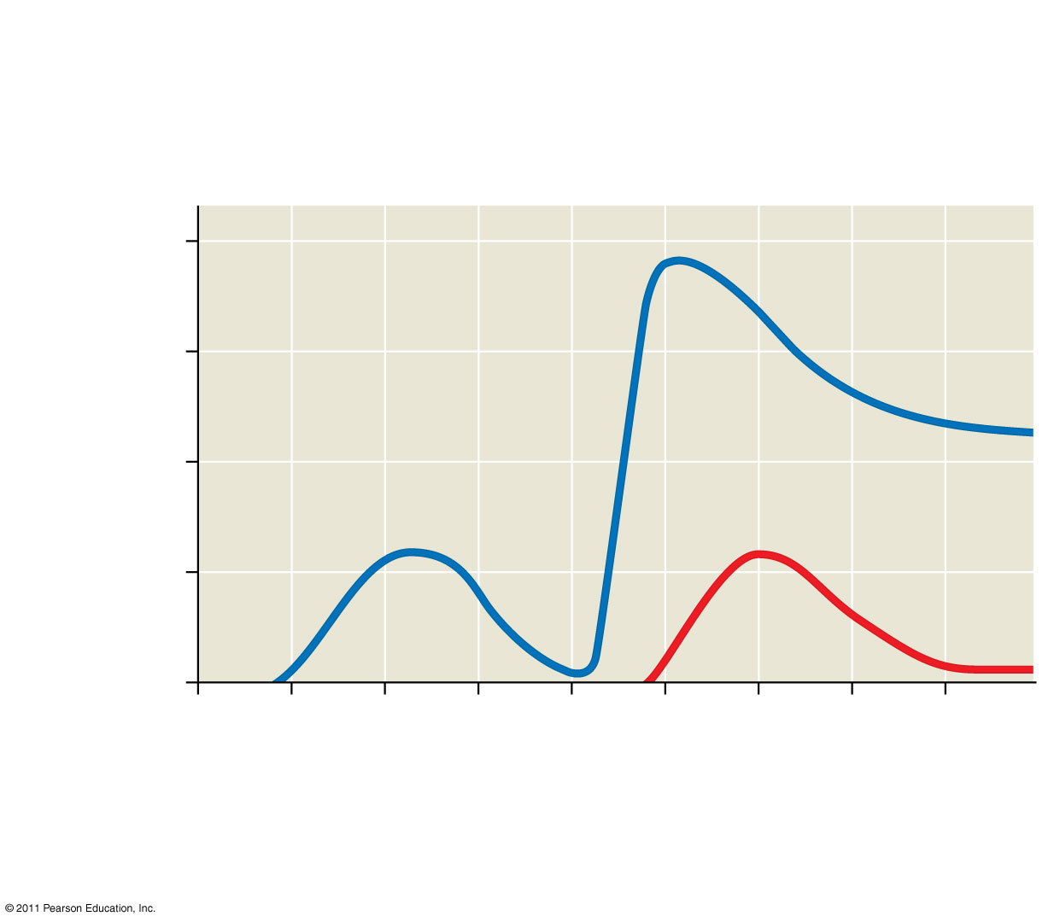
Figure 43.15
Primary immune response to antigen A produces antibodies to A.
Secondary immune response to antigen A produces antibodies to A; primary immune response to antigen B produces antibodies to B.
10⁴
10³
Antibodies to A
Antibody concentration (arbitrary units)
10²
Antibodies to B
10¹
10⁰
0
7
14
21
28
35
42
49
56
Exposure to antigen A
Exposure to antigens A and B
Time (days)
Notes:
Figure 43.15 The specificity of immunological memory.

Slide 142
Concept 43.3: Adaptive immunity defends against infection of body fluids and body cells
Acquired immunity has two branches: the humoral immune response and the cell-mediated immune response
In the humoral immune response antibodies help neutralize or eliminate toxins and pathogens in the blood and lymph
In the cell-mediated immune response specialized T cells destroy affected host cells
© 2011 Pearson Education, Inc.

Slide 143
Helper T Cells: A Response to Nearly All Antigens
A type of T cell called a helper T cell triggers both the humoral and cell-mediated immune responses
Signals from helper T cells initiate production of antibodies that neutralize pathogens and activate T cells that kill infected cells
Antigen-presenting cells have class I and class II MHC molecules on their surfaces
© 2011 Pearson Education, Inc.

Slide 144
Class II MHC molecules are the basis upon which antigen-presenting cells are recognized
Antigen receptors on the surface of helper T cells bind to the antigen and the class II MHC molecule; then signals are exchanged between the two cells
The helper T cell is activated, proliferates, and forms a clone of helper T cells, which then activate the appropriate B cells
Animation: Helper T Cells
© 2011 Pearson Education, Inc.

Slide 145
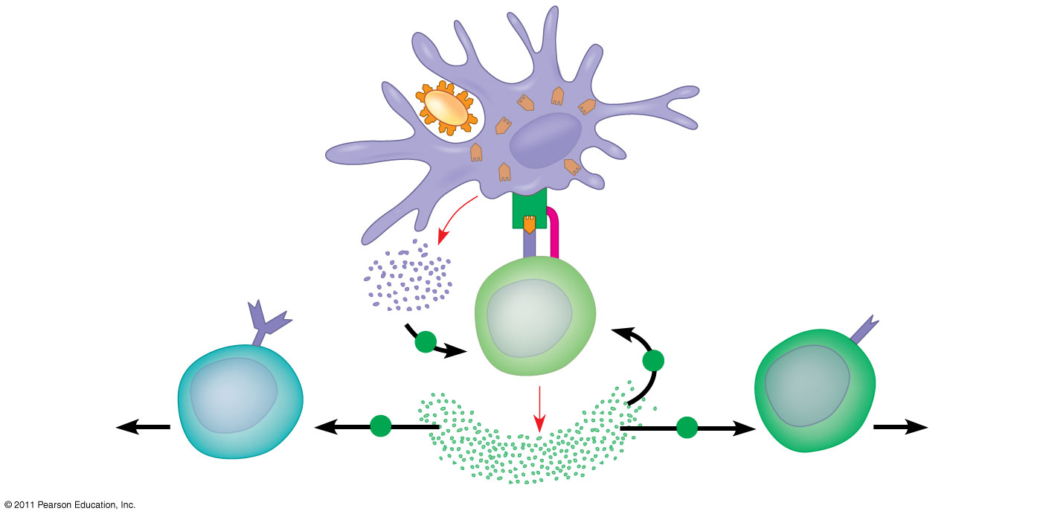
Figure 43.16
Antigen- presenting cell
Antigen fragment
Pathogen
Class II MHC molecule
1
Accessory protein
Antigen receptor
Helper T cell
+
Cytokines
+
Humoral immunity
2
Cell- mediated immunity
+
+
B cell
3
Cytotoxic T cell
Notes:
Figure 43.16 The central role of helper T cells in humoral and cell-mediated immune responses.

Slide 146
Cytotoxic T Cells: A Response to Infected Cells
Cytotoxic T cells are the effector cells in the cell-mediated immune response
Cytotoxic T cells recognize fragments of foreign proteins produced by infected cells and possess an accessory protein that binds to class I MHC molecules
The activated cytotoxic T cell secretes proteins that disrupt the membranes of target cells and trigger apoptosis
Animation: Cytotoxic T Cells
© 2011 Pearson Education, Inc.

Slide 147
Figure 43.17-1
Cytotoxic T cell
Accessory protein
Antigen receptor
Class I MHC molecule
Infected cell
Antigen fragment
1
Notes:
Figure 43.17 The killing action of cytotoxic T cells on an infected host cell.

Slide 148
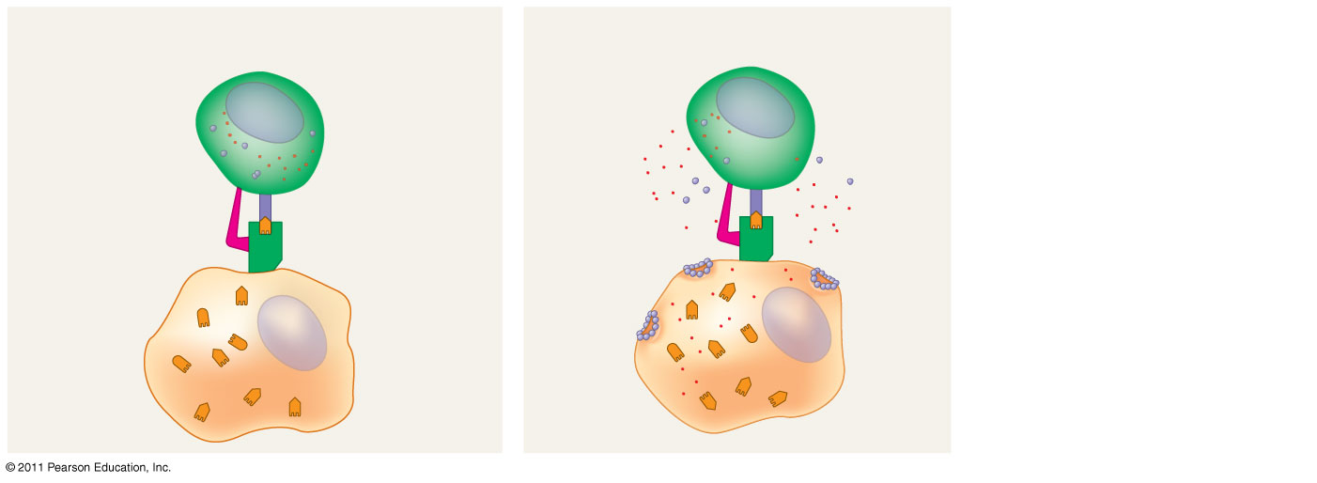
Figure 43.17-2
Cytotoxic T cell
Accessory protein
Antigen receptor
Class I MHC molecule
Perforin
Gran- zymes
Pore
Infected cell
Antigen fragment
1
2
Notes:
Figure 43.17 The killing action of cytotoxic T cells on an infected host cell.

Slide 149
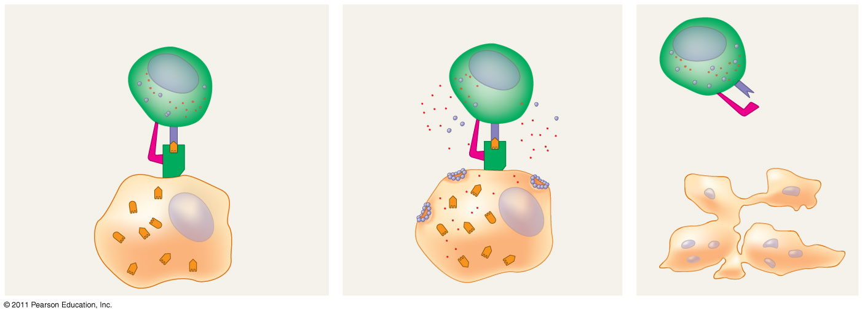
Figure 43.17-3
Cytotoxic T cell
Released cytotoxic T cell
Accessory protein
Antigen receptor
Dying infected cell
Class I MHC molecule
Perforin
Gran- zymes
Pore
Infected cell
Antigen fragment
1
2
3
Notes:
Figure 43.17 The killing action of cytotoxic T cells on an infected host cell.

Slide 150
B Cells and Antibodies: A Response to Extracellular Pathogens
The humoral response is characterized by secretion of antibodies by B cells
© 2011 Pearson Education, Inc.

Slide 151
Activation of B Cells
Activation of the humoral immune response involves B cells and helper T cells as well as proteins on the surface of pathogens
In response to cytokines from helper T cells and an antigen, a B cell proliferates and differentiates into memory B cells and antibody- secreting effector cells called plasma cells
© 2011 Pearson Education, Inc.

Slide 152
Figure 43.18-1
Antigen-presenting cell
Pathogen
Antigen fragment
Class II MHC molecule
Accessory protein
Antigen receptor
Helper T cell
1
Notes:
Figure 43.18 Activation of a B cell in the humoral immune response.

Slide 153
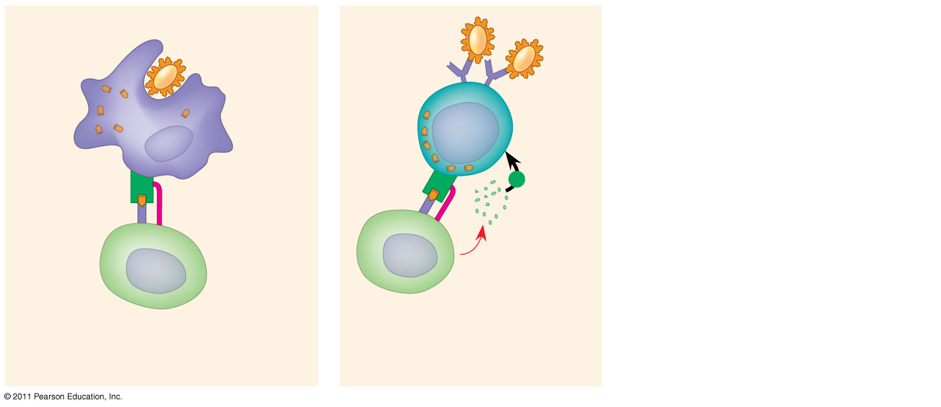
Figure 43.18-2
Antigen-presenting cell
Pathogen
Antigen fragment
B cell
Class II MHC molecule
+
Accessory protein
Antigen receptor
Cytokines
Activated helper T cell
Helper T cell
1
2
Notes:
Figure 43.18 Activation of a B cell in the humoral immune response.

Slide 154
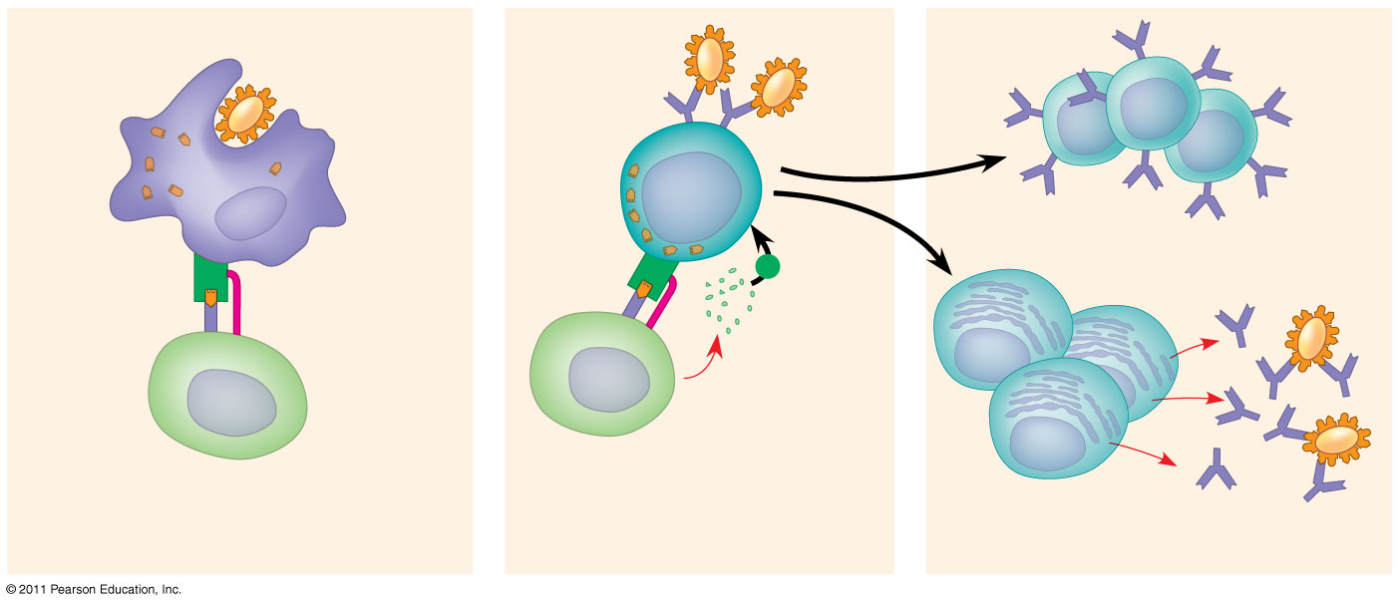
Figure 43.18-3
Antigen-presenting cell
Pathogen
Antigen fragment
B cell
Class II MHC molecule
Memory B cells
+
Accessory protein
Antigen receptor
Cytokines
Activated helper T cell
Plasma cells
Helper T cell
Secreted antibodies
1
2
3
Notes:
Figure 43.18 Activation of a B cell in the humoral immune response.

Slide 155
Antibody Function
Antibodies do not kill pathogens; instead they mark pathogens for destruction
In neutralization, antibodies bind to viral surface proteins preventing infection of a host cell
Antibodies may also bind to toxins in body fluids and prevent them from entering body cells
© 2011 Pearson Education, Inc.

Slide 156
In opsonization, antibodies bind to antigens on bacteria creating a target for macrophages or neutrophils, triggering phagocytosis
Antigen-antibody complexes may bind to a complement protein—which triggers a cascade of complement protein activation
Ultimately a membrane attack complex forms a pore in the membrane of the foreign cell, leading to its lysis
© 2011 Pearson Education, Inc.

Slide 157
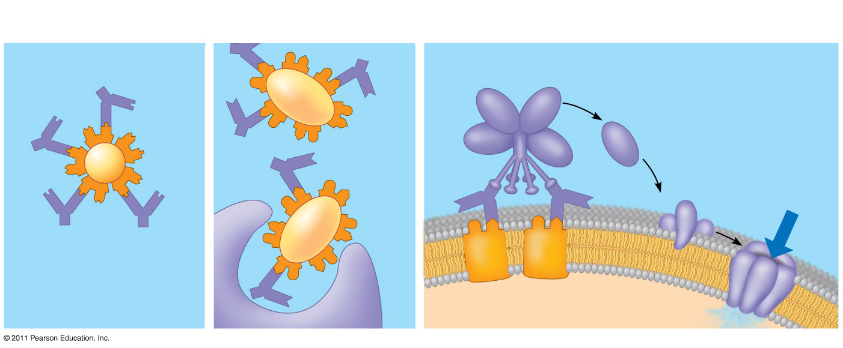
Figure 43.19
Activation of complement system and pore formation
Neutralization
Opsonization
Complement proteins
Antibody
Formation of membrane attack complex
Virus
Bacterium
Flow of water and ions
Pore
Foreign cell
Antigen
Macrophage
Notes:
Figure 43.19 Antibody-mediated mechanisms of antigen disposal.

Slide 158
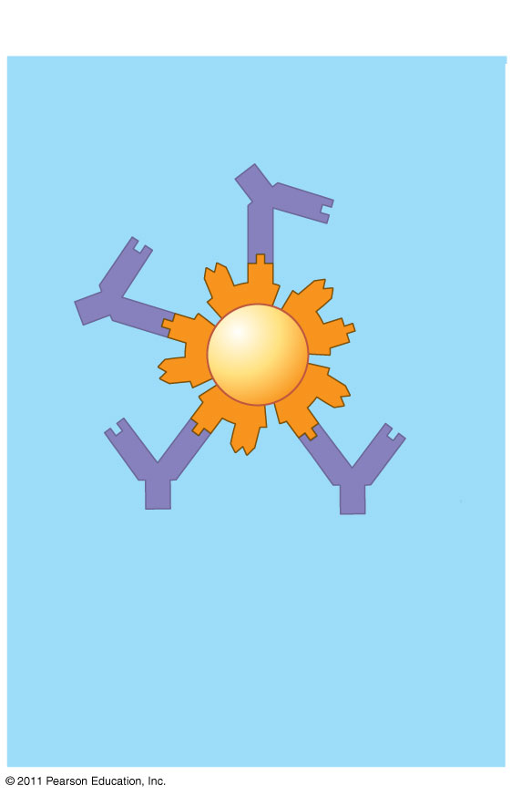
Figure 43.19a
Neutralization
Antibody
Virus
Notes:
Figure 43.19 Antibody-mediated mechanisms of antigen disposal.

Slide 159
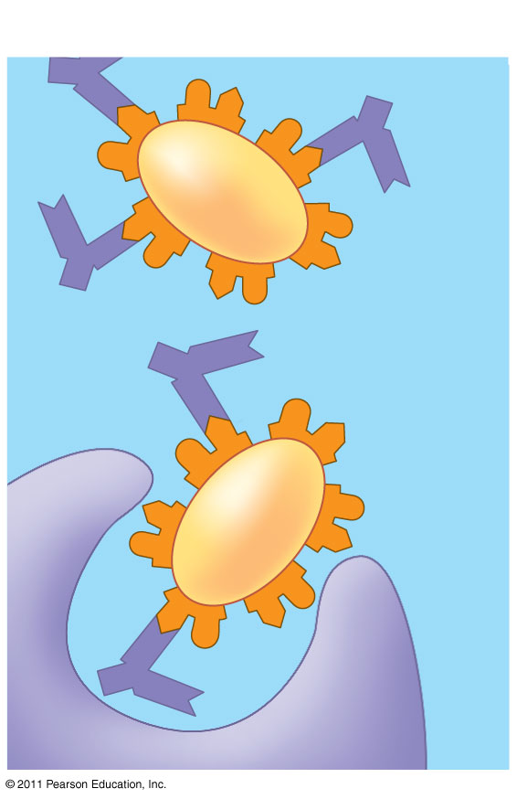
Figure 43.19b
Opsonization
Bacterium
Macrophage
Notes:
Figure 43.19 Antibody-mediated mechanisms of antigen disposal.

Slide 160
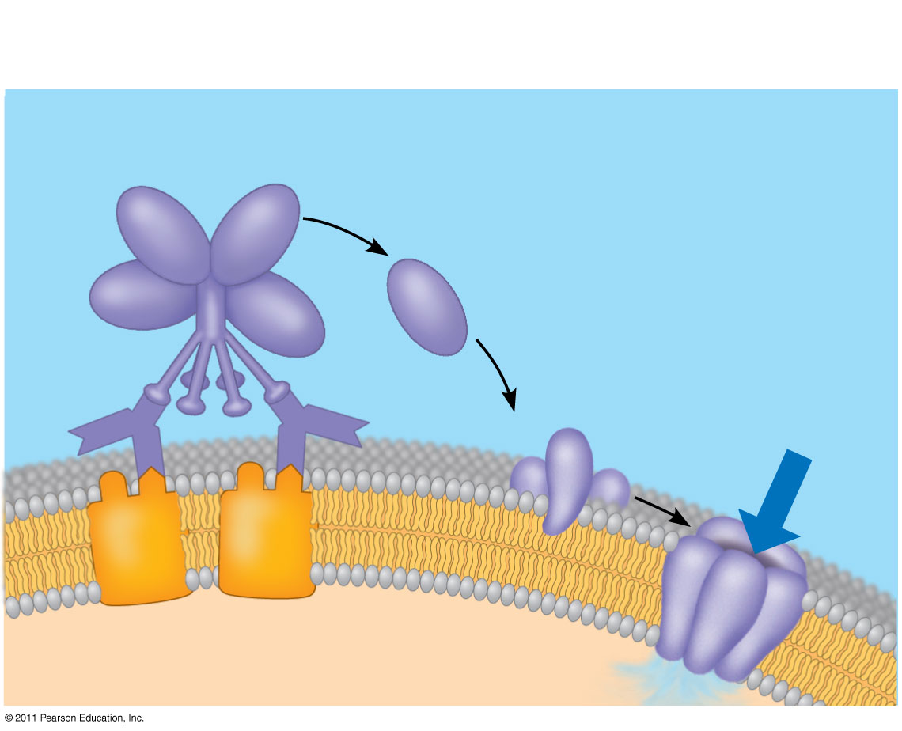
Figure 43.19c
Activation of complement system and pore formation
Complement proteins
Formation of membrane attack complex
Flow of water and ions
Pore
Foreign cell
Antigen
Notes:
Figure 43.19 Antibody-mediated mechanisms of antigen disposal.

Slide 161
B cells can express five different forms (or classes) of immunoglobulin (Ig) with similar antigen-binding specificity but different heavy chain C regions
IgD: Membrane bound
IgM: First soluble class produced
IgG: Second soluble class; most abundant
IgA and IgE: Remaining soluble classes
© 2011 Pearson Education, Inc.

Slide 162
Summary of the Humoral and Cell-Mediated Immune Responses
Both the humoral and cell-mediated responses can include primary and secondary immune response
Memory cells enable the secondary response
© 2011 Pearson Education, Inc.

Slide 163
Active and Passive Immunization
Active immunity develops naturally when memory cells form clones in response to an infection
It can also develop following immunization, also called vaccination
In immunization, a nonpathogenic form of a microbe or part of a microbe elicits an immune response to an immunological memory
© 2011 Pearson Education, Inc.

Slide 164
Passive immunity provides immediate, short-term protection
It is conferred naturally when IgG crosses the placenta from mother to fetus or when IgA passes from mother to infant in breast milk
It can be conferred artificially by injecting antibodies into a nonimmune person
© 2011 Pearson Education, Inc.

Slide 165
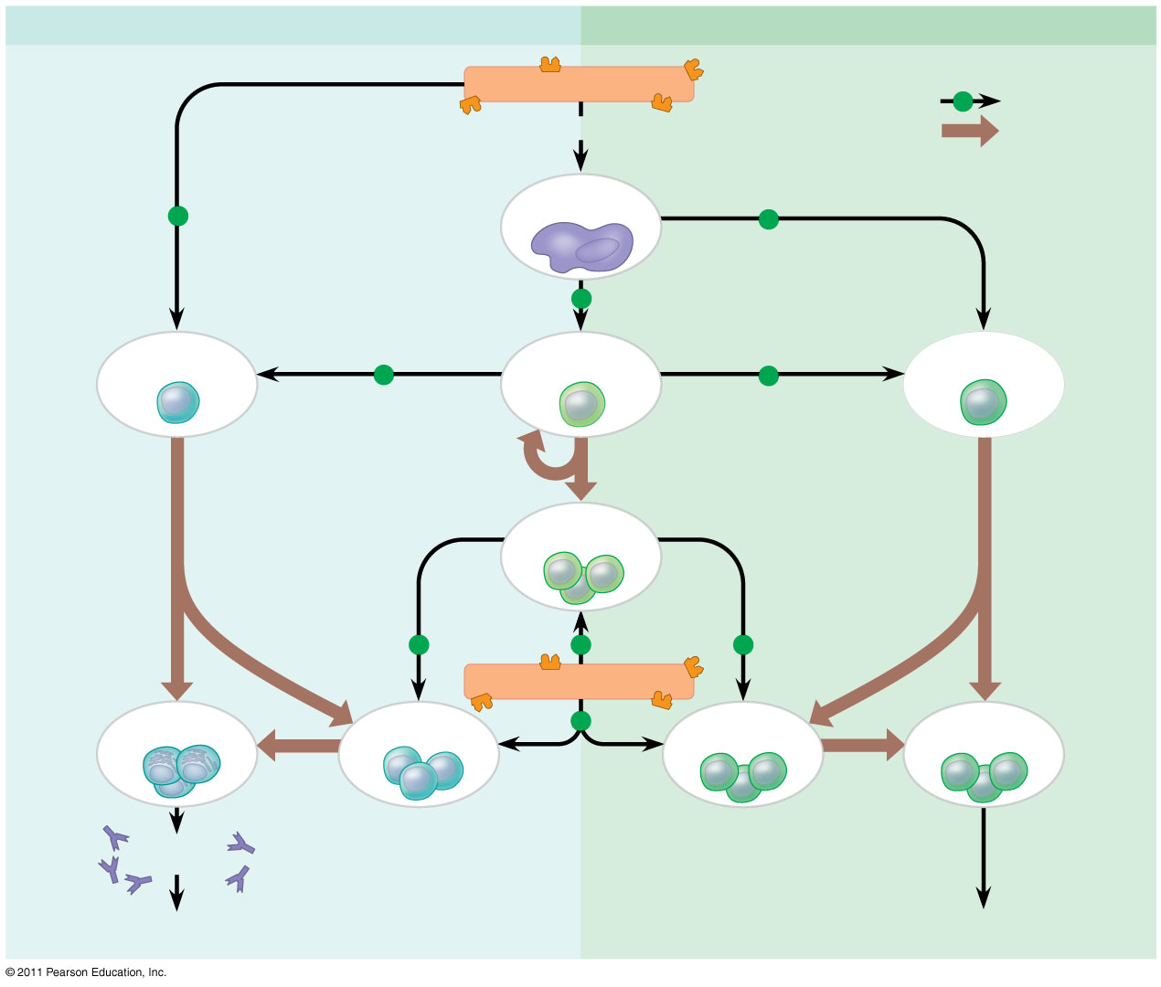
Figure 43.20
Humoral (antibody-mediated) immune response
Cell-mediated immune response
Antigen (1st exposure)
Key
+
Stimulates
Engulfed by
Gives rise to
Antigen- presenting cell
+
+
+
B cell
+
Helper T cell
+
Cytotoxic T cell
Memory helper T cells
+
+
+
Antigen (2nd exposure)
Plasma cells
Memory B cells
+
Memory cytotoxic T cells
Active cytotoxic T cells
Secreted antibodies
Defend against extracellular pathogens
Defend against intracellular pathogens and cancer
Notes:
Figure 43.20 An overview of the adaptive immune response.

Slide 166
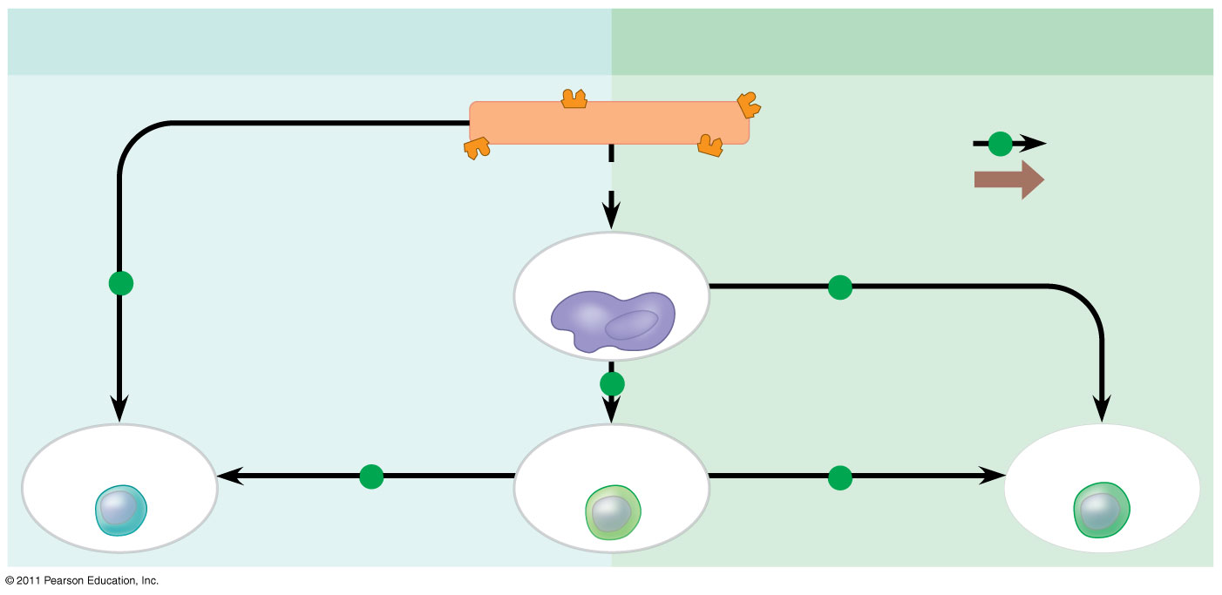
Figure 43.20a
Humoral (antibody-mediated) immune response
Cell-mediated immune response
+
Antigen (1st exposure)
Key
+
Stimulates
Engulfed by
Gives rise to
Antigen- presenting cell
+
+
+
B cell
+
Helper T cell
+
Cytotoxic T cell
Notes:
Figure 43.20 An overview of the adaptive immune response.

Slide 167
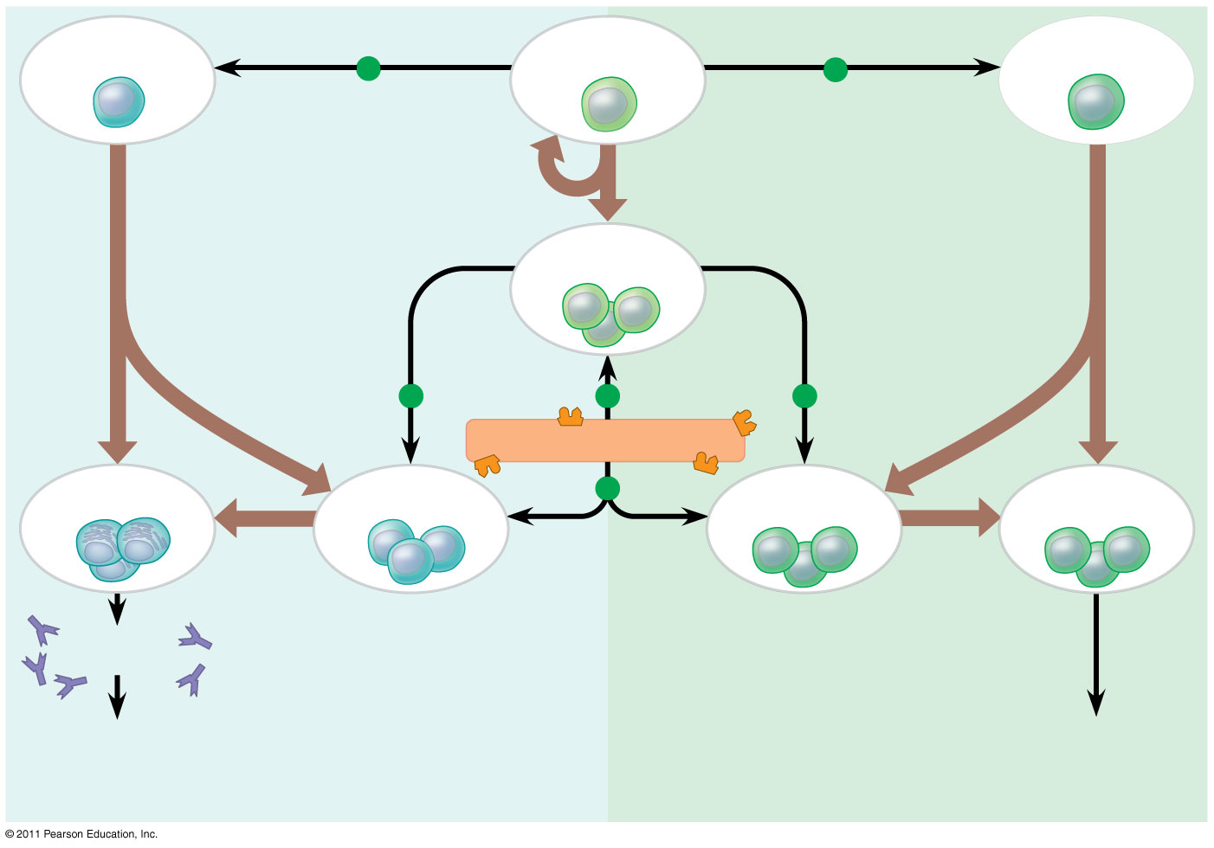
Figure 43.20b
B cell
+
Helper T cell
+
Cytotoxic T cell
Memory helper T cells
+
+
+
Antigen (2nd exposure)
+
Memory cytotoxic T cells
Active cytotoxic T cells
Plasma cells
Memory B cells
Secreted antibodies
Defend against extracellular pathogens
Defend against intracellular pathogens and cancer
Notes:
Figure 43.20 An overview of the adaptive immune response.

Slide 168
Antibodies as Tools
Antibody specificity and antigen-antibody binding have been harnessed in research, diagnosis, and therapy
Polyclonal antibodies, produced following exposure to a microbial antigen, are products of many different clones of plasma cells, each specific for a different epitope
Monoclonal antibodies are prepared from a single clone of B cells grown in culture
© 2011 Pearson Education, Inc.

Slide 169
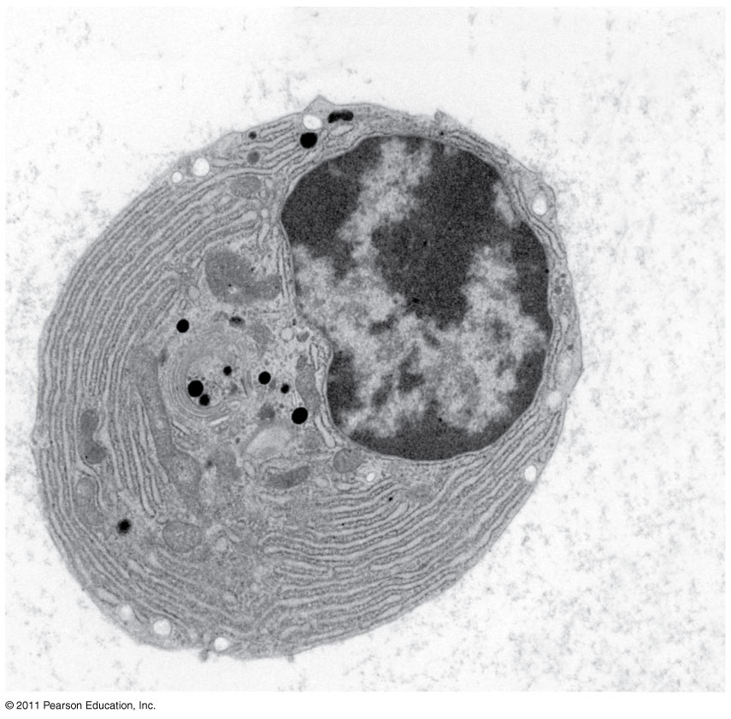
Figure 43.21
Endoplasmic reticulum of plasma cell
2 μm
Notes:
Figure 43.21 A plasma cell.

Slide 170
Immune Rejection
Cells transferred from one person to another can be attacked by immune defenses
This complicates blood transfusions or the transplant of tissues or organs
© 2011 Pearson Education, Inc.

Slide 171
Blood Groups
Antigens on red blood cells determine whether a person has blood type A (A antigen), B (B antigen), AB (both A and B antigens), or O (neither antigen)
Antibodies to nonself blood types exist in the body
Transfusion with incompatible blood leads to destruction of the transfused cells
Recipient-donor combinations can be fatal or safe
© 2011 Pearson Education, Inc.

Slide 172
Tissue and Organ Transplants
MHC molecules are different among genetically nonidentical individuals
Differences in MHC molecules stimulate rejection of tissue grafts and organ transplants
© 2011 Pearson Education, Inc.

Slide 173
Chances of successful transplantation increase if donor and recipient MHC tissue types are well matched
Immunosuppressive drugs facilitate transplantation
Lymphocytes in bone marrow transplants may cause the donor tissue to reject the recipient
© 2011 Pearson Education, Inc.

Slide 174
Concept 43.4: Disruptions in immune system function can elicit or exacerbate disease
Some pathogens have evolved to diminish the effectiveness of host immune responses
© 2011 Pearson Education, Inc.

Slide 175
Exaggerated, Self-Directed, and Diminished Immune Responses
If the delicate balance of the immune system is disrupted, effects range from minor to sometimes fatal
© 2011 Pearson Education, Inc.

Slide 176
Allergies
Allergies are exaggerated (hypersensitive) responses to antigens called allergens
In localized allergies such as hay fever, IgE antibodies produced after first exposure to an allergen attach to receptors on mast cells
© 2011 Pearson Education, Inc.

Slide 177
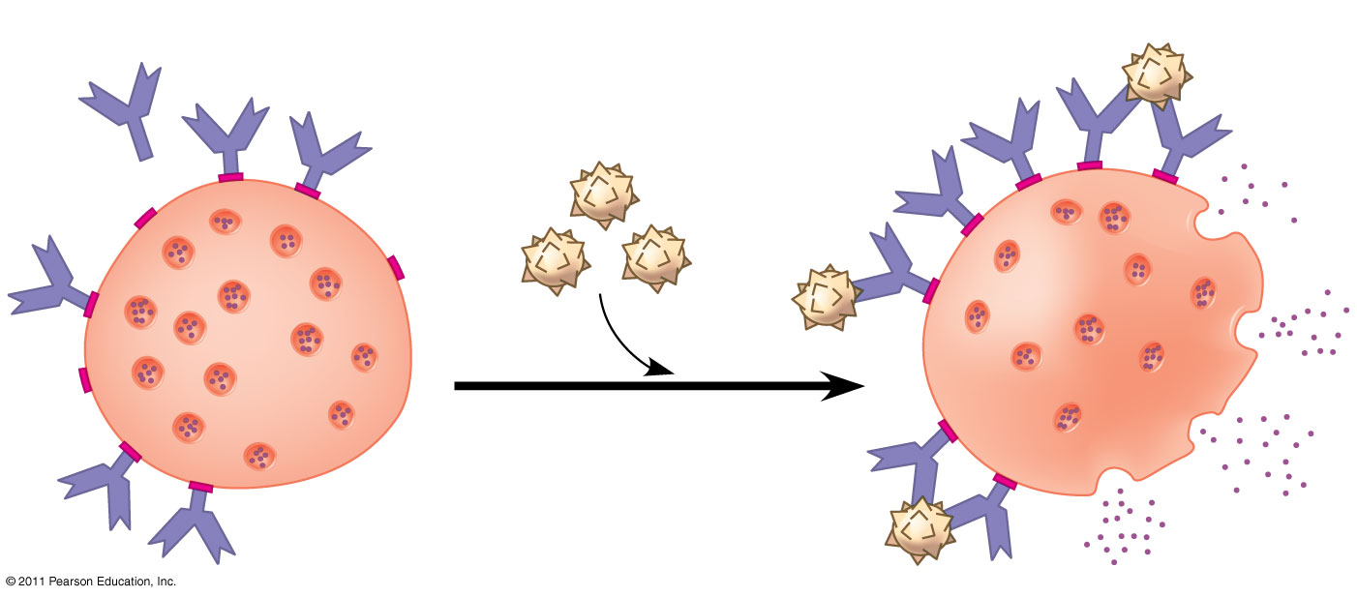
Figure 43.22
Histamine
IgE
Allergen
Granule
Mast cell
Notes:
Figure 43.22 Mast cells, IgE, and the allergic response.

Slide 178
The next time the allergen enters the body, it binds to mast cell–associated IgE molecules
Mast cells release histamine and other mediators that cause vascular changes leading to typical allergy symptoms
An acute allergic response can lead to anaphylactic shock, a life-threatening reaction, within seconds of allergen exposure
© 2011 Pearson Education, Inc.

Slide 179
Autoimmune Diseases
In individuals with autoimmune diseases, the immune system loses tolerance for self and turns against certain molecules of the body
Autoimmune diseases include systemic lupus erythematosus, rheumatoid arthritis, insulin-dependent diabetes mellitus, and multiple sclerosis
© 2011 Pearson Education, Inc.

Slide 180
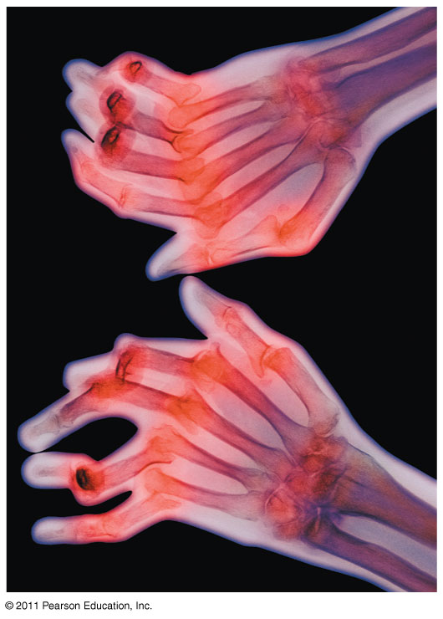
Figure 43.23
Notes:
Figure 43.23 X-ray of hands deformed by rheumatoid arthritis.

Slide 181
Exertion, Stress, and the Immune System
Moderate exercise improves immune system function
Psychological stress has been shown to disrupt immune system regulation by altering the interactions of the hormonal, nervous, and immune systems
Sufficient rest is also important for immunity
© 2011 Pearson Education, Inc.

Slide 182
Immunodeficiency Diseases
Inborn immunodeficiency results from hereditary or developmental defects that prevent proper functioning of innate, humoral, and/or cell-mediated defenses
Acquired immunodeficiency develops later in life and results from exposure to chemical and biological agents
Acquired immunodeficiency syndrome (AIDS) is caused by a virus
© 2011 Pearson Education, Inc.

Slide 183
Evolutionary Adaptations of Pathogens That Underlie Immune System Avoidance
Pathogens have evolved mechanisms to thwart immune responses
© 2011 Pearson Education, Inc.

Slide 184
Antigenic Variation
Through antigenic variation, some pathogens are able to change epitope expression and prevent recognition
The human influenza virus mutates rapidly, and new flu vaccines must be made each year
Human viruses occasionally exchange genes with the viruses of domesticated animals
This poses a danger as human immune systems are unable to recognize the new viral strain
© 2011 Pearson Education, Inc.

Slide 185
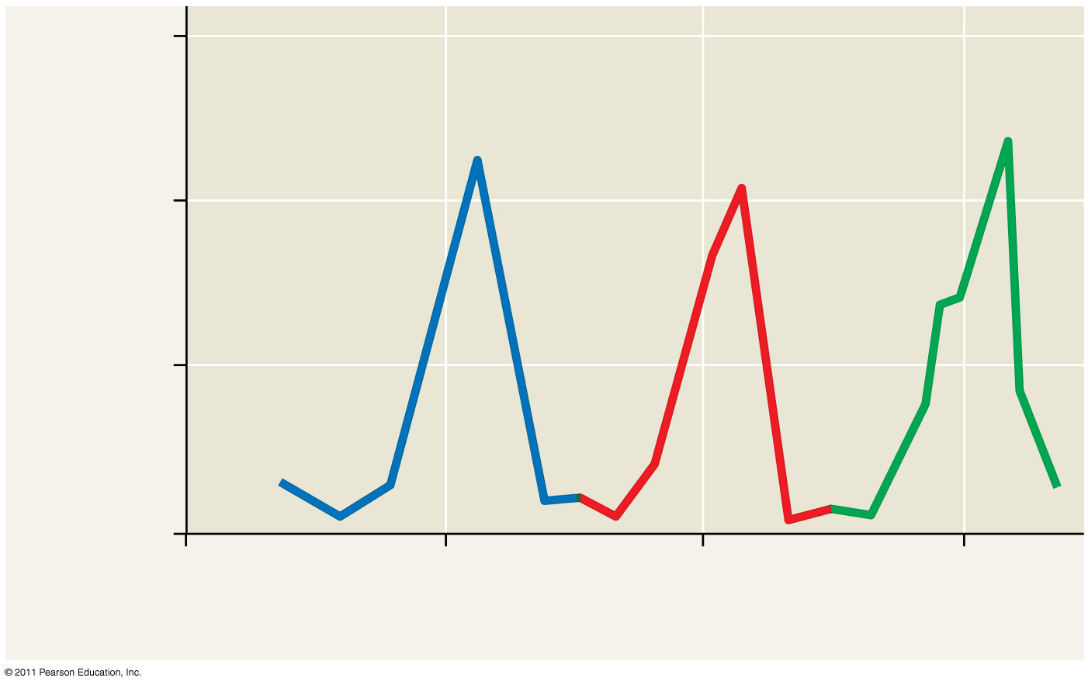
Figure 43.24
1.5
Antibodies to variant 1 appear
Antibodies to variant 2 appear
Antibodies to variant 3 appear
1.0
Millions of parasites per mL of blood
Variant 1
Variant 2
Variant 3
0.5
0
25
26
27
28
Weeks after infection
Notes:
Figure 43.24 Antigenic variation in the parasite that causes sleeping sickness.

Slide 186
Latency
Some viruses may remain in a host in an inactive state called latency
Herpes simplex viruses can be present in a human host without causing symptoms
© 2011 Pearson Education, Inc.

Slide 187
Attack on the Immune System: HIV
Human immunodeficiency virus (HIV) infects helper T cells
The loss of helper T cells impairs both the humoral and cell-mediated immune responses and leads to AIDS
HIV eludes the immune system because of antigenic variation and an ability to remain latent while integrated into host DNA
Animation: HIV Reproductive Cycle
© 2011 Pearson Education, Inc.

Slide 188
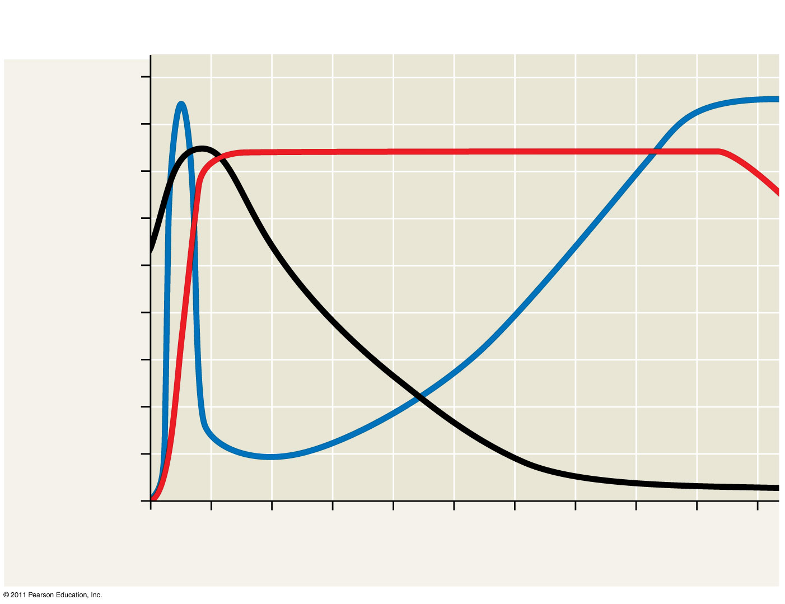
Figure 43.25
Latency
AIDS
Relative anti-HIV antibody concentration
800
Relative HIV concentration
600
Helper T cell concentration (in blood (cells/mm³)
Helper T cell concentration
400
200
0
0
1
2
3
4
5
6
7
8
9
10
Years after untreated infection
Notes:
Figure 43.25 The progress of an untreated HIV infection.

Slide 189
People with AIDS are highly susceptible to opportunistic infections and cancers that take advantage of an immune system in collapse
The spread of HIV is a worldwide problem
The best approach for slowing this spread is education about practices that transmit the virus
© 2011 Pearson Education, Inc.

Slide 190
Cancer and Immunity
The frequency of certain cancers increases when adaptive immunity is impaired
20% of all human cancers involve viruses
The immune system can act as a defense against viruses that cause cancer and cancer cells that harbor viruses
In 2006, a vaccine was released that acts against human papillomavirus (HPV), a virus associated with cervical cancer
© 2011 Pearson Education, Inc.

Slide 191
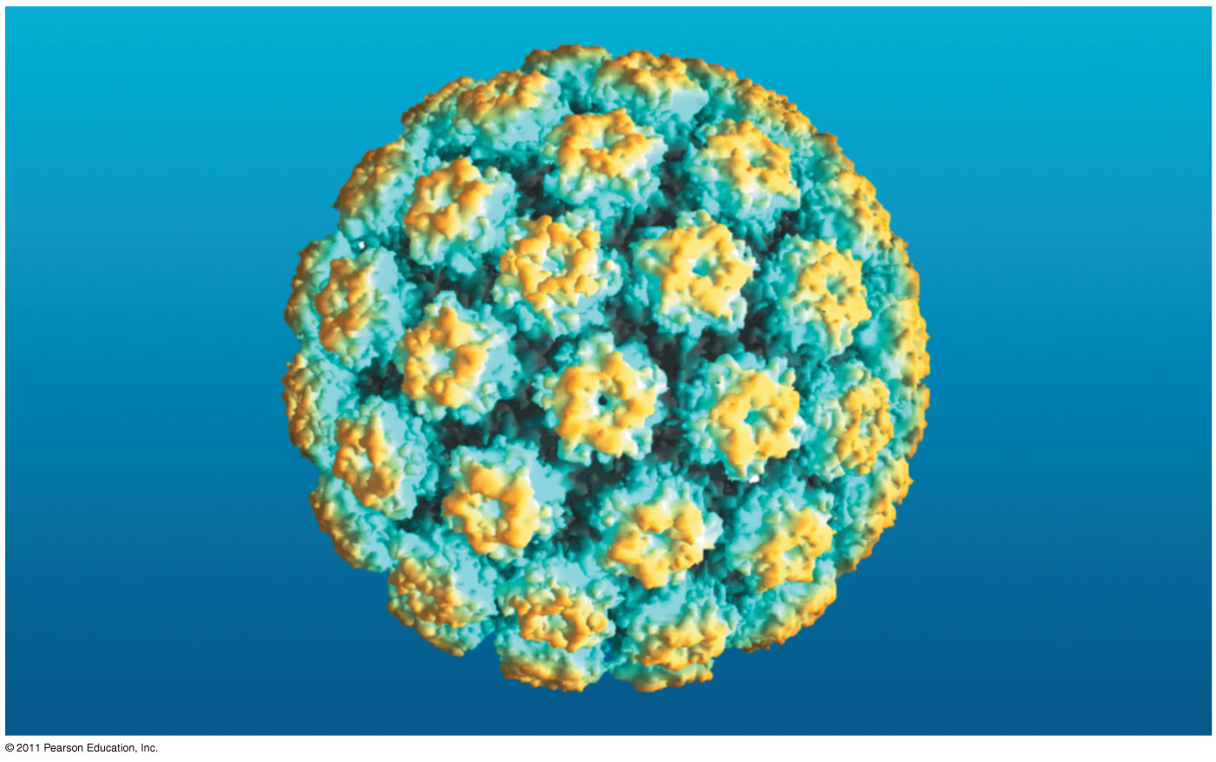
Figure 43.26
Notes:
Figure 43.26 Impact: Vaccinating Against Cervical Cancer

Slide 192
Figure 43.UN02
Stem cell
Cell division and gene rearrangement
Elimination of self-reactive B cells
Antigen
Clonal selection
Formation of activated cell populations
Antibody
Memory B cells
Plasma cells
Pathogen
Receptors bind to antigens
Notes:
Figure 43.UN02 Summary figure, Concept 43.2

Slide 193
Figure 43.UN03
Notes:
Figure 43.UN03 Appendix A: answer to Test Your Understanding, question 8

